Slide 1
How to Be
a Safe Person
Defensiveness: Do You Want a Teachable Spirit ?
Ephesians 4:29

Slide 2
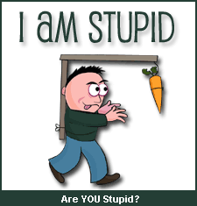
Proverbs 12:1 NIV
Whoever loves discipline loves knowledge,
but whoever hates correction is stupid.

Slide 3
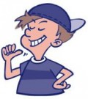
Proverbs 15:12 Message
Know-it-alls don’t like being told what to do;
they avoid the company of wise men and women.

Slide 4
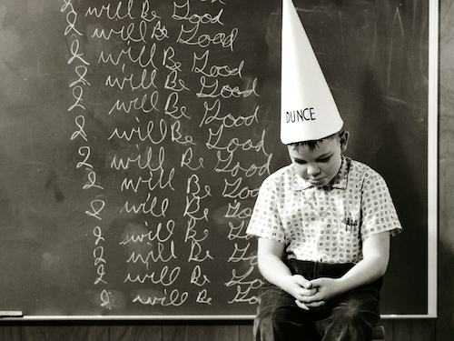
Proverbs 17:10 CEV
A sensible person accepts correction,
but you can’t beat sense into a fool

Slide 5
Be Attentive
-
Look at the Person,
Listen carefully,
nod your head and
respond

Slide 6
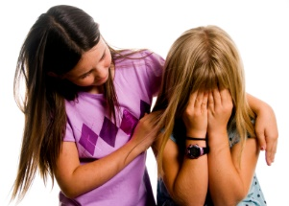
SHOW CONCERN Acknowledge the Person’s willingness to share information with you and show your concern if a problem exists.

Slide 7
ASK QUESTIONS – BE CURIOUS, NOT DEFENSIVE.
Ask a few questions if needed to clarify what the feedback is about,
but do not interrogate the person or appear to challenge the Person.

Slide 8
APOLOGIZE
(If appropriate)
Apologize for any role you
might have had in the problem.

Slide 9
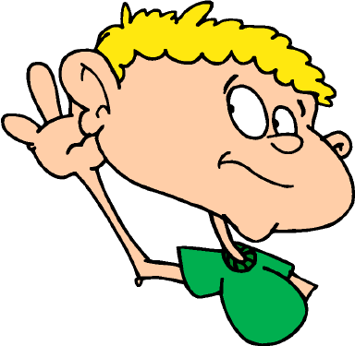
DON’T MAKE EXCUSES OR INTERRUPT
Don’t interrupt the Person or try to explain your side of the situation at this point,
just listen and try to reinforce the person for caring enough about you to share this information.

Slide 10
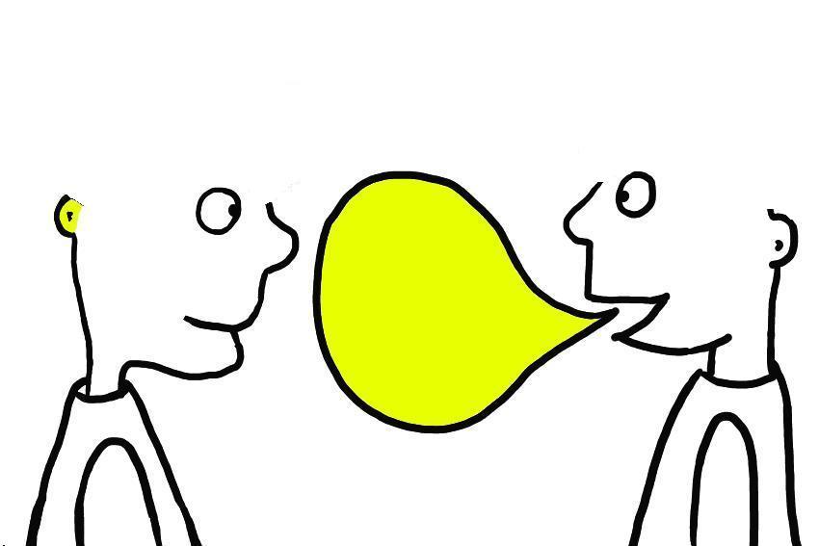
DISCUSS THE SITUATION
If the feedback is complex and requires some discussion about how to solve a problem,
ask for suggestions and focus on achieving a constructive solution

Slide 11
ASK FOR MORE FEEDBACK
Ask the Person if there is anything else you can do.

Slide 12
THANK THE PERSON FOR THE FEEDBACK
Thank the Person for being concerned for sharing the information with you.

Slide 13
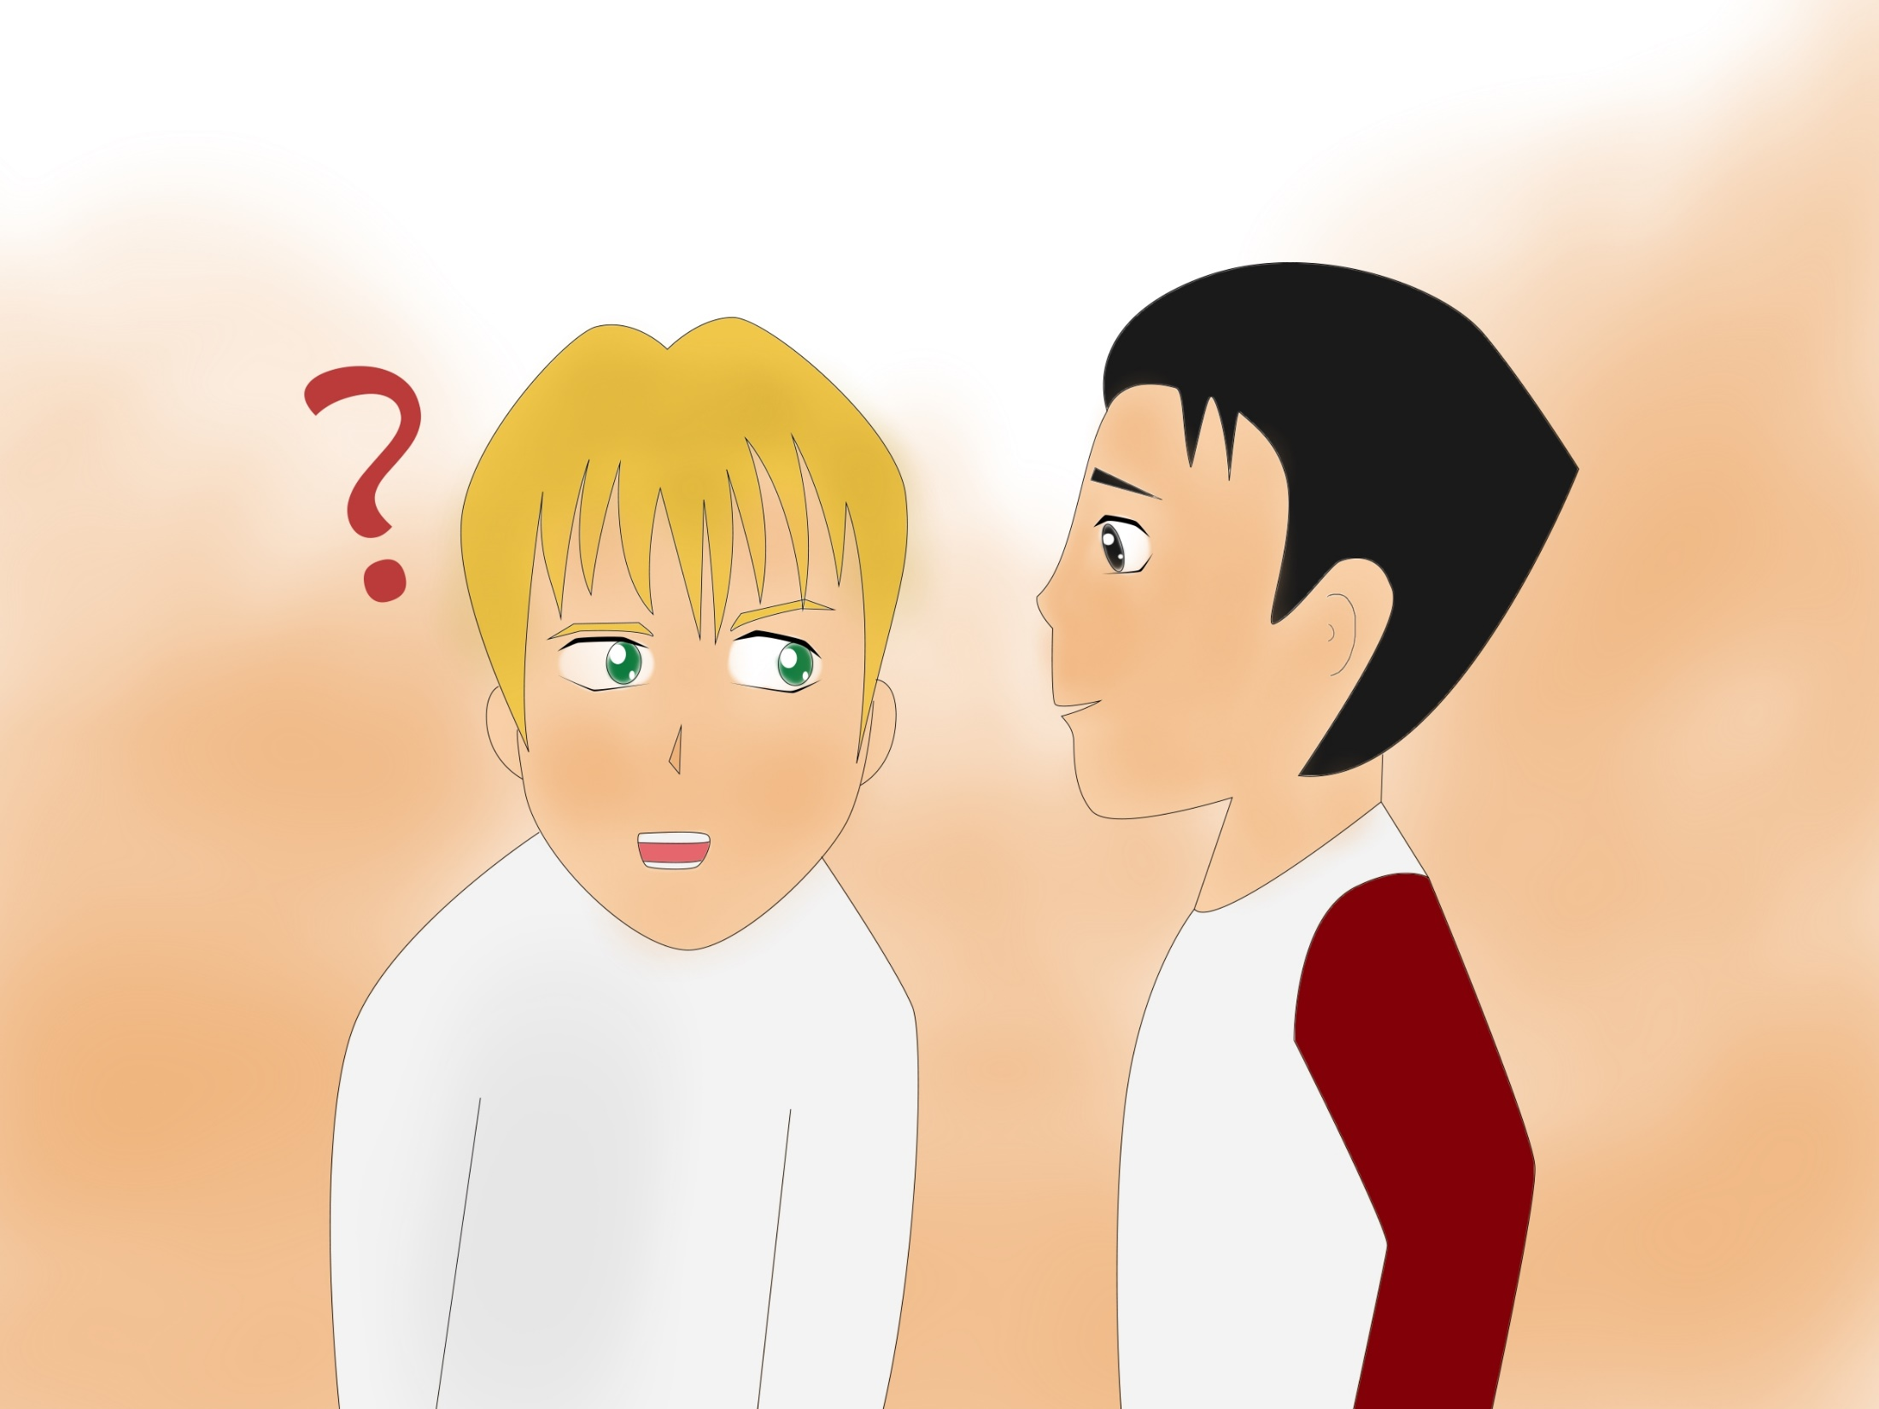
ASK FOR FUTURE FEEDBACK
Ask the Person to let you know if this happens again.

Slide 14
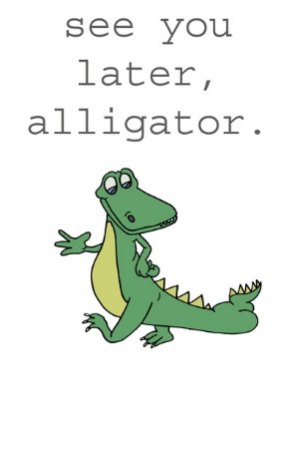
CHECK BACK
Ask the Person if you can check back in a few days or weeks to see whether the problem has been solved.

Slide 15
Ephesians 4:29 NIV
Let no unwholesome talk come out of your mouths, but only what is helpful for building others up.

Slide 16
Table Sharing
Is it difficult for you to accept feedback and if so why?
What does a teachable spirit look like?
What do you need to do to have a teachable spirit?

