Slide 1
The I AM Series:
“I AM
a peculiar God”

Slide 2
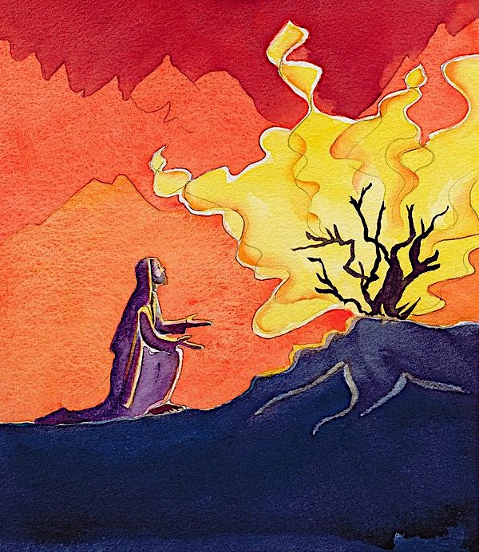

Slide 3
Exodus 3:13
¹³ But Moses said to God, “If I now come to the Israelites and say to them, ‘The God of your ancestors has sent me to you,’ they are going to ask me, ‘What’s this God’s name?’ What am I supposed to say to them?”

Slide 4
Exodus 3:14-15
¹⁴ God said to Moses, “I Am Who I Am.^{[b]} So say to the Israelites, ‘I Am has sent me to you.’” ¹⁵ God continued, “Say to the Israelites, ‘The Lord, the God of your ancestors, Abraham’s God, Isaac’s God, and Jacob’s God, has sent me to you.’ This is my name forever; this is how all generations will remember me.

Slide 5
Exodus 3:16
¹⁶ “Go and get Israel’s elders together and say to them, ‘The Lord, the God of your ancestors, the God of Abraham, of Isaac, and of Jacob, has appeared to me.

Slide 6
“God”
Elohim

Slide 7
“the Lord”
Adonai

Slide 8
“the LORD”
YHWH

Slide 10
Exodus 5:22 – 6:11
Then Moses turned to the Lord and said, “My Lord, why have you abused this people? Why did you send me for this? ²³ Ever since I first came to Pharaoh to speak in your name, he has abused this people. And you’ve done absolutely nothing to rescue your people.”

Slide 11
The Lord replied to Moses, “Now you will see what I’ll do to Pharaoh. In fact, he’ll be so eager to let them go that he’ll drive them out of his land by force.”
² God also said to Moses: “I am the Lord. ³ I appeared to Abraham, Isaac, and Jacob as God Almighty, but I didn’t reveal myself to them by my name ‘The Lord.’

Slide 12
⁴ I also set up my covenant with them to give them the land of Canaan where they lived as immigrants. ⁵ I’ve also heard the cry of grief of the Israelites, whom the Egyptians have turned into slaves, and I’ve remembered my covenant.

Slide 13
Therefore, say to the Israelites, ‘I am the Lord. I’ll bring you out from Egyptian forced labor. I’ll rescue you from your slavery to them. I’ll set you free with great power and with momentous events of justice. ⁷ I’ll take you as my people, and I’ll be your God. You will know that I, the Lord, am your God, who has freed you from Egyptian forced labor.

Slide 14
⁸ I’ll bring you into the land that I promised to give to Abraham, Isaac, and Jacob. I’ll give it to you as your possession. I am the Lord.’” ⁹ Moses told this to the Israelites. But they didn’t listen to Moses, because of their complete exhaustion and their hard labor.

Slide 15
⁸ I’ll bring you into the land that I promised to give to Abraham, Isaac, and Jacob. I’ll give it to you as your possession. I am the Lord.’” ⁹ Moses told this to the Israelites. But they didn’t listen to Moses, because of their complete exhaustion and their hard labor.

Slide 16
¹⁰ Then the Lord said to Moses, ¹¹ “Go and tell Pharaoh, Egypt’s king, to let the Israelites out of his land.”
¹² But Moses said to the Lord, “The Israelites haven’t even listened to me. How can I expect Pharaoh to listen to me, especially since I’m not a very good speaker?”

Slide 17
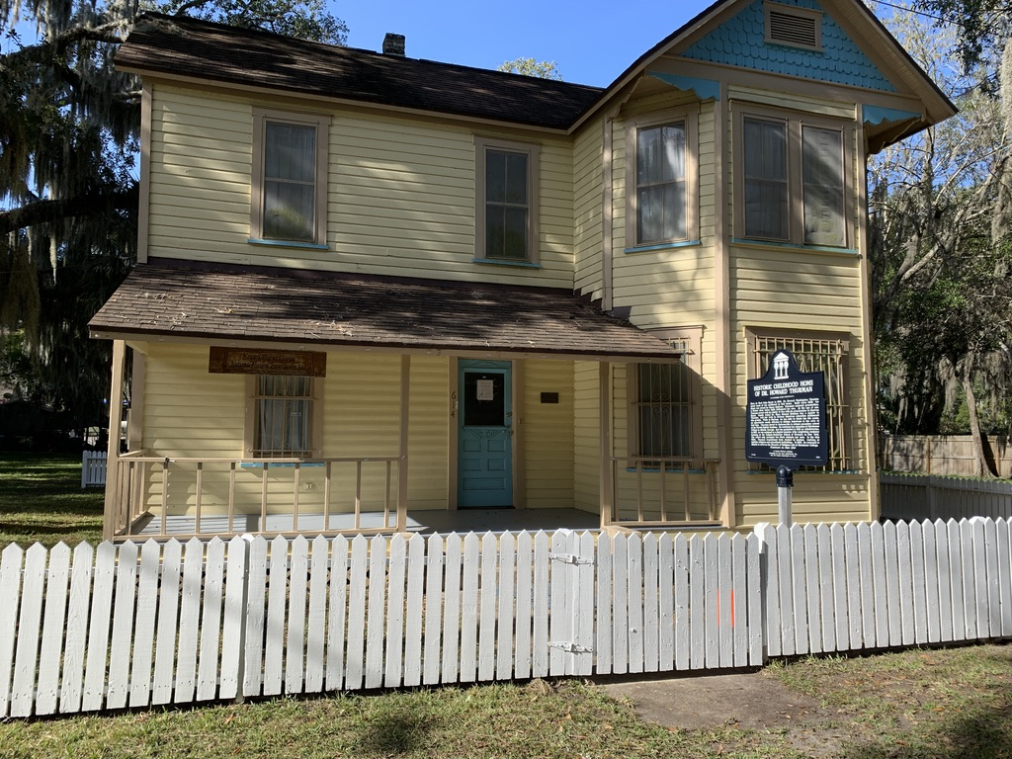

Slide 18
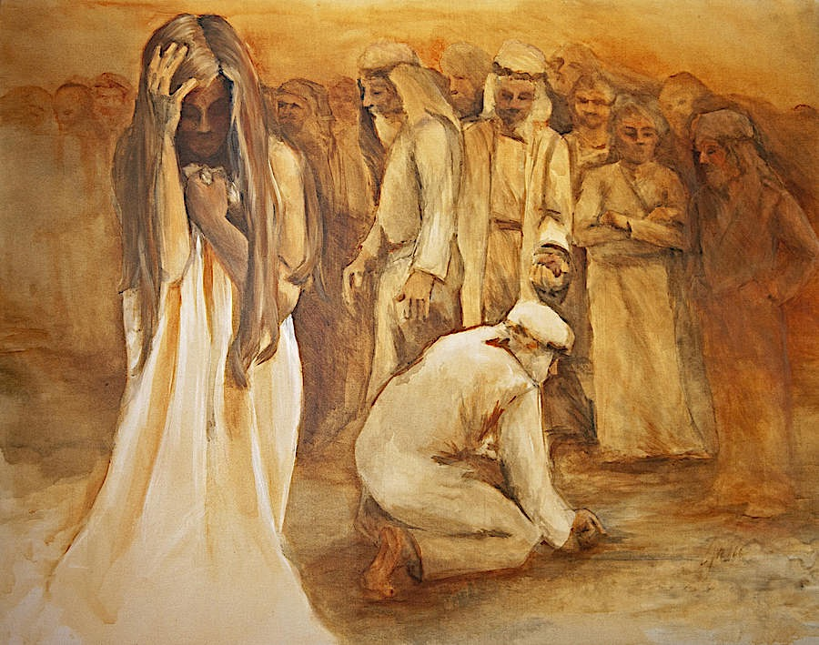

Slide 19
He placed a crown upon her head which for the rest of her life she would keep trying to grow tall enough to wear.
~ Howard Thurman

