Slide 1
The One Another Series
Admonish One Another

Slide 2
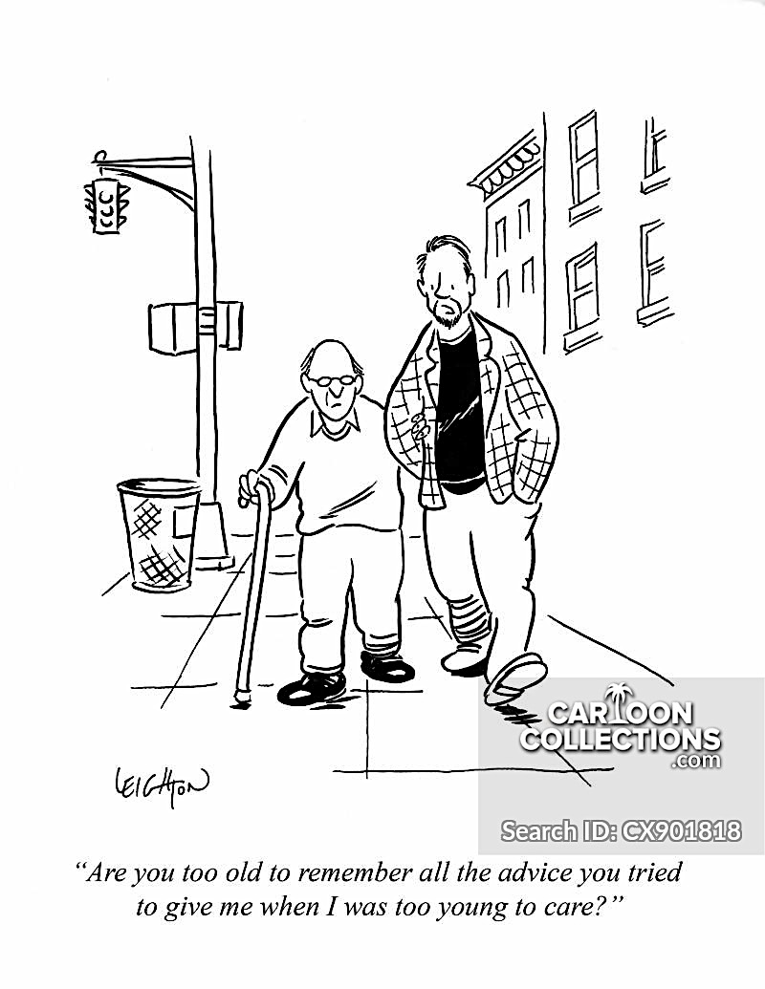

Slide 3
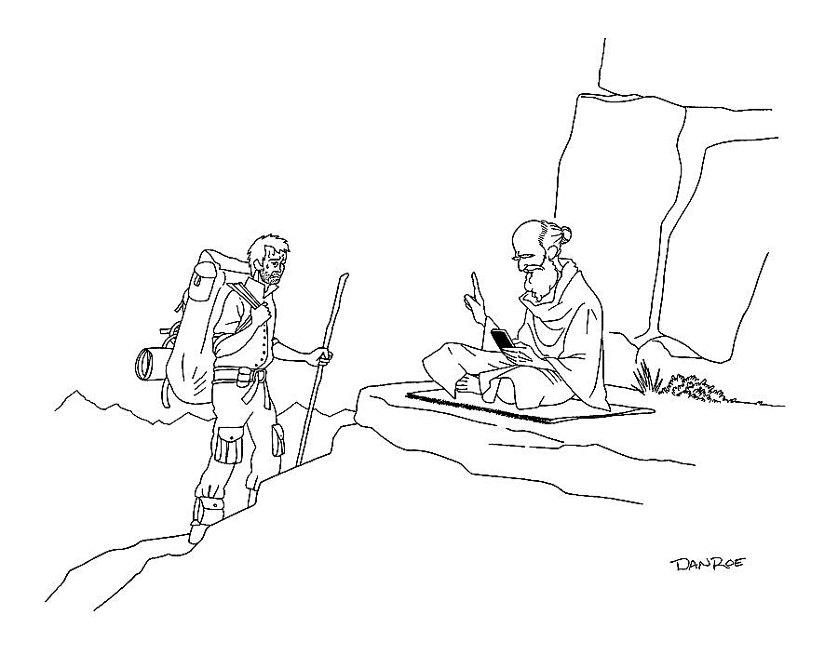

Slide 4
The Malachi Story
Israel was captive b/c they were disobedient
God delivers them back to Israel w/a new Temple
They are joyful . . . living faithful and then
They stop being faithful and they get lazy with God

Slide 5
And then the magic happens . . .
Then those who feared the Lord talked with each other, and the Lord listened and heard.
- Malachi 3:16

Slide 6
97 Oh, how I love your law! - TORAH
I meditate on it all day long.
98 Your commands are always with me
and make me wiser than my enemies.
99 I have more insight than all my teachers,
for I meditate on your statutes.
100 I have more understanding than the elders,
for I obey your precepts.
101 I have kept my feet from every evil path
so that I might obey your word.

Slide 7
TORAH = Instruction
(way of life)

Slide 8
Be very careful, then, how y’all live—not as unwise but as wise, 16 making the most of every opportunity, because the days are evil. 17 Therefore do not be foolish, but understand what the Lord’s will is. 18 Do not get drunk on wine, which leads to debauchery. Instead, be filled with the Spirit, 19 speaking to one another with psalms, hymns, and songs from the Spirit. Sing and make music from y’all’s heart to the Lord, 20 always giving thanks to God the Father for everything, in the name of our Lord Jesus Christ.

Slide 9
Be very careful, then, how you live—not as unwise but as wise, making the most of every opportunity, because the days are evil. Therefore do not be foolish, but understand what the Lord’s will is. Do not get drunk on wine, which leads to debauchery. Instead, be filled with the Spirit, speaking to one another with psalms, hymns, and songs from the Spirit. Sing and make music from your heart to the Lord, always giving thanks to God the Father for everything, in the name of our Lord Jesus Christ.
– Ephesians 5:15-20

Slide 10
“I wonder if this is what God is doing . . . what do you think?”
“What do you think God could be up to . . . do you have any ideas for me?”

