Slide 1
RESTORING God’s Dream
The Promise of Sexual Healing and Wholeness

Slide 2
Christian Marriage: For Starters
Ephesians 5:21-33
The Sequel

Slide 3
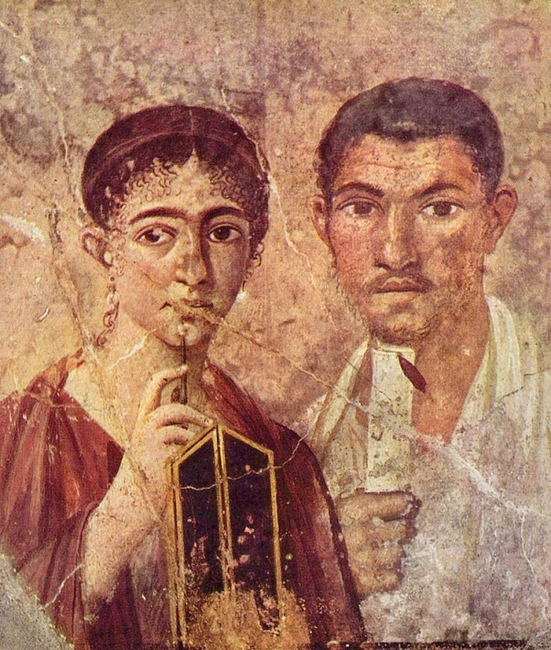
A married couple, from Pompeii, in the 1st Century.
+ + +
They had a “fiery” relationship.

Slide 4
Household Codes:
Kept the family in line for the sake of the Roman Empire.
Paul makes the “codes” radical.

Slide 5
Paul’s Model for Marriage and Family:
The foundation is siblinghood in Christ.
Jesus is the model for marriage.
Marriage is not just for the married. Marriage belongs to the church.

Slide 6
Everyone can live without sex.

Slide 7
No one can live without love.

Slide 8
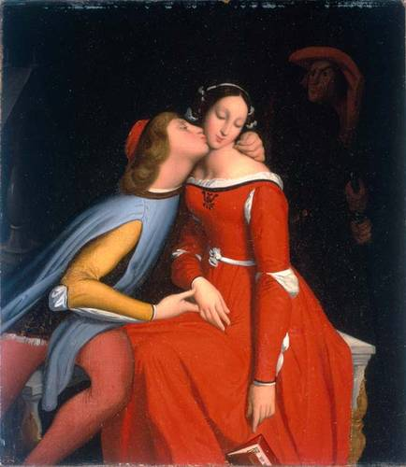
¡Porneia!
AKA
fornication
Paola & Francesca
from
Danté’s INFERNO

Slide 9
Genesis 2 “creation”
Mark 10:1-16 “divorce, etc.”
Ephesians 5:8-33 “submission”
I Corinthians 7 “sex”

