Slide 1
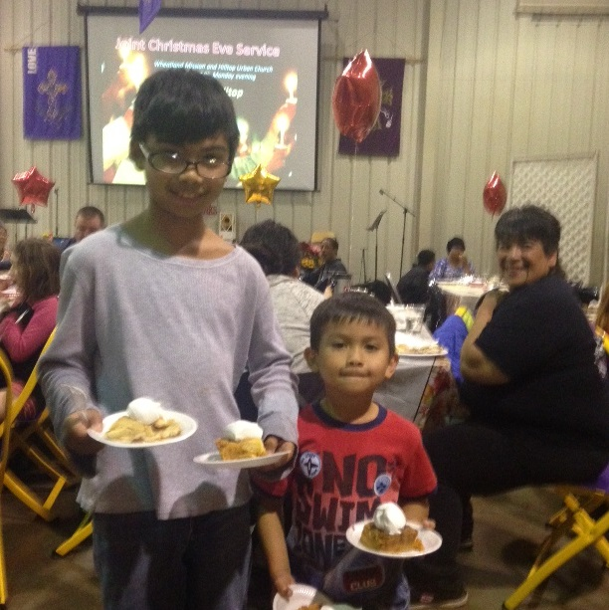
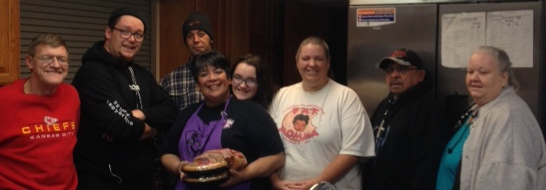
Hospitality

Slide 2
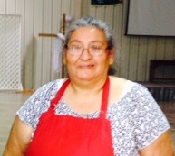
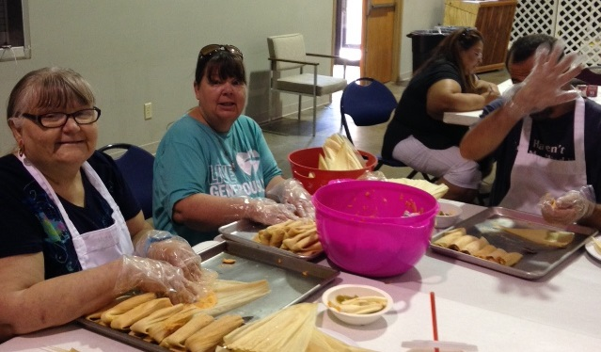
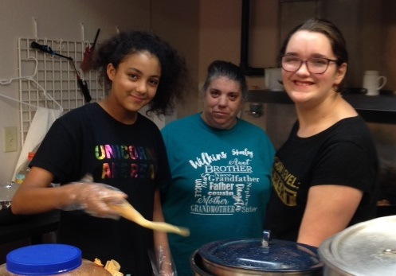
“Show hospitality to one another.”
1 Peter 4:9 ESV

Slide 3
[ hos-pi-tal-i-tee ]
noun
The friendly reception and treatment of guests or strangers.

Slide 4
When have you experienced hospitality?
What did it look like?

Slide 5
Listening
Smile
Greeting
Hug
Meal
Place to stay

Slide 6
Have you ever visited a church where you did not feel welcomed?
What did that look like?

Slide 7
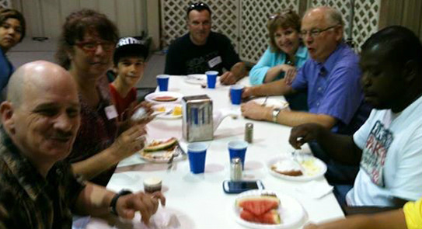
Manna Meal

Slide 8
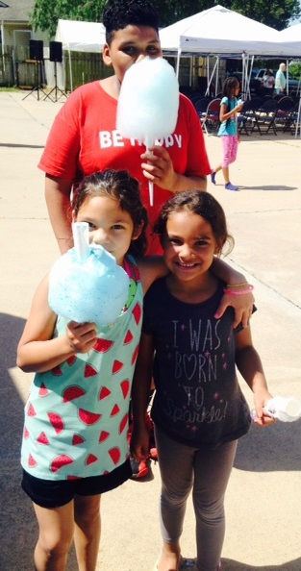
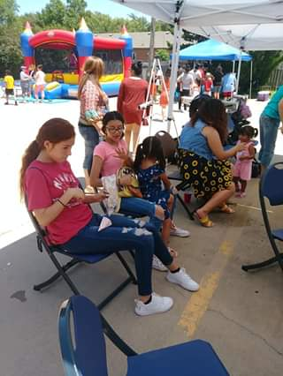
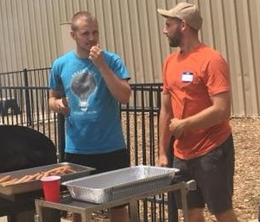
HUB Block Party

Slide 9
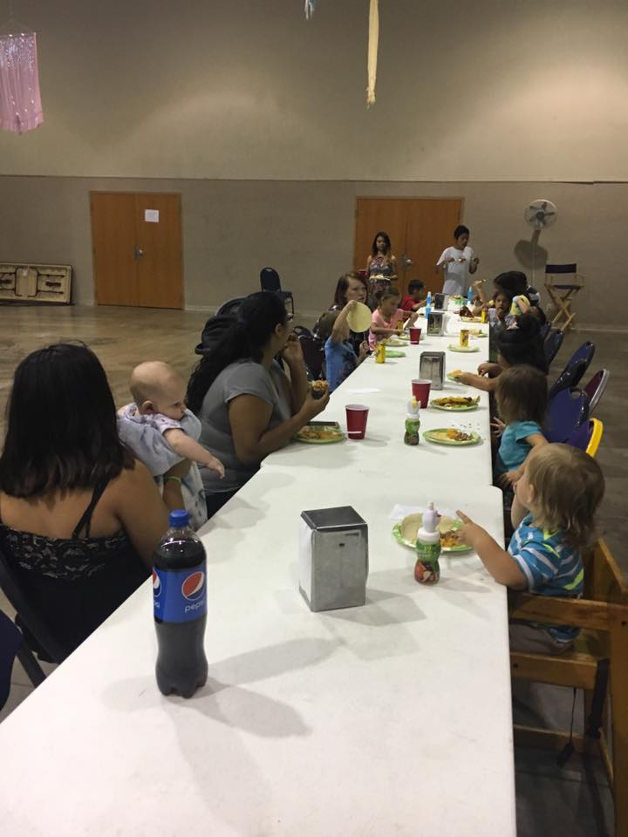
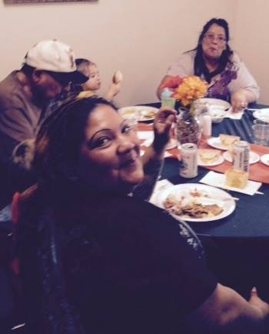
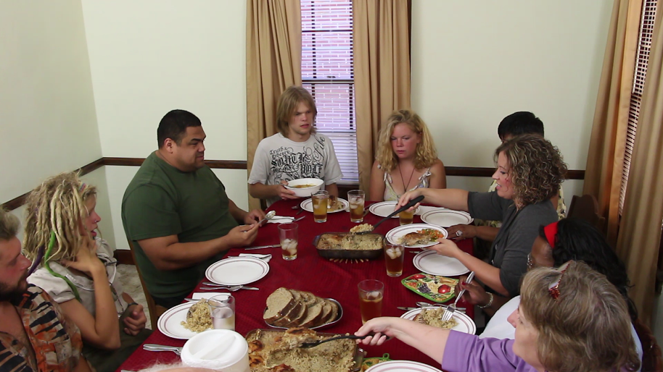
5 House Churches
* Breathe * House of Misfits
*The Change * House of Healing
* House of Transformation

Slide 10
Benedictine hospitality is more than simply thinking new thoughts or feeling new feelings about people we either thought harshly of before, or, more likely, failed to think about at all.
Benedictine hospitality demands that we open our lives to others as well.

Slide 11
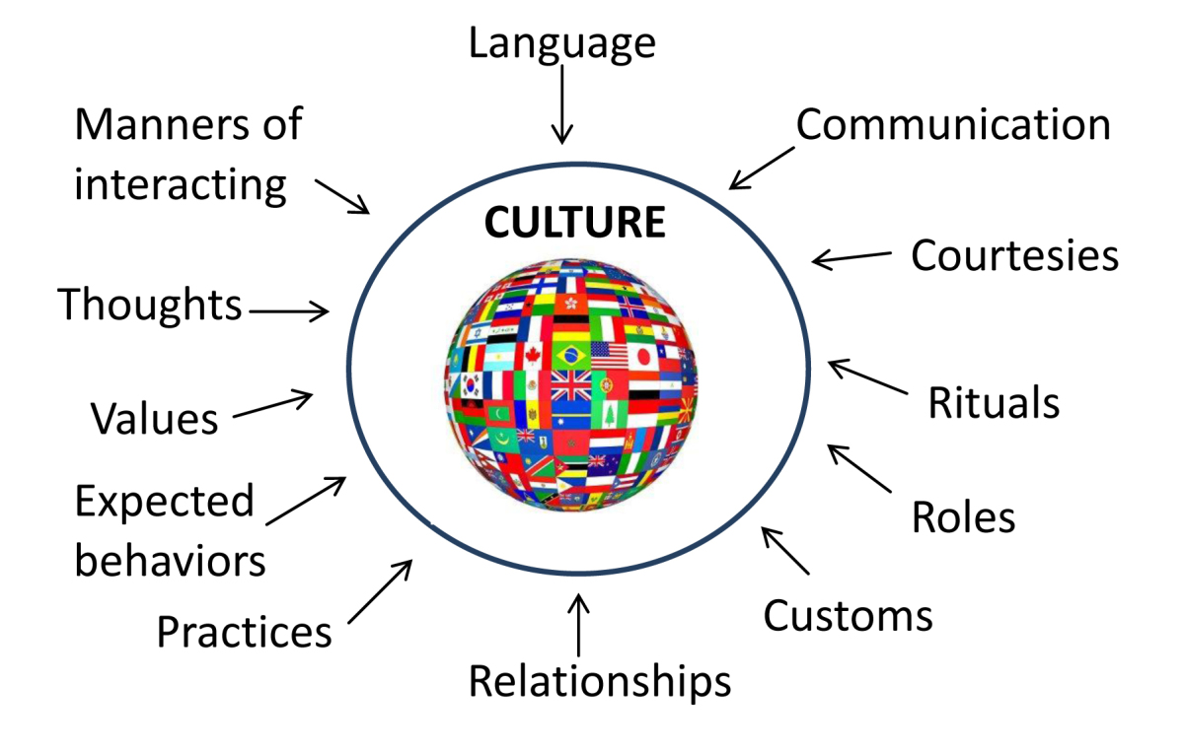

Slide 12
“Hot or “Cold" Culture?
Hot (sometimes rural/tribal) cultures most highly value relationships.
Cold (sometimes urban) cultures most highly value efficiency.
Are you from a hot or a cold culture?

Slide 13
Anglo-Americans are often concerned with time. To avoid scheduling conflicts they may prefer for someone to call before dropping by their home.
Many other cultures, however, consider it an honor to receive guests at any time, even unannounced.

Slide 14
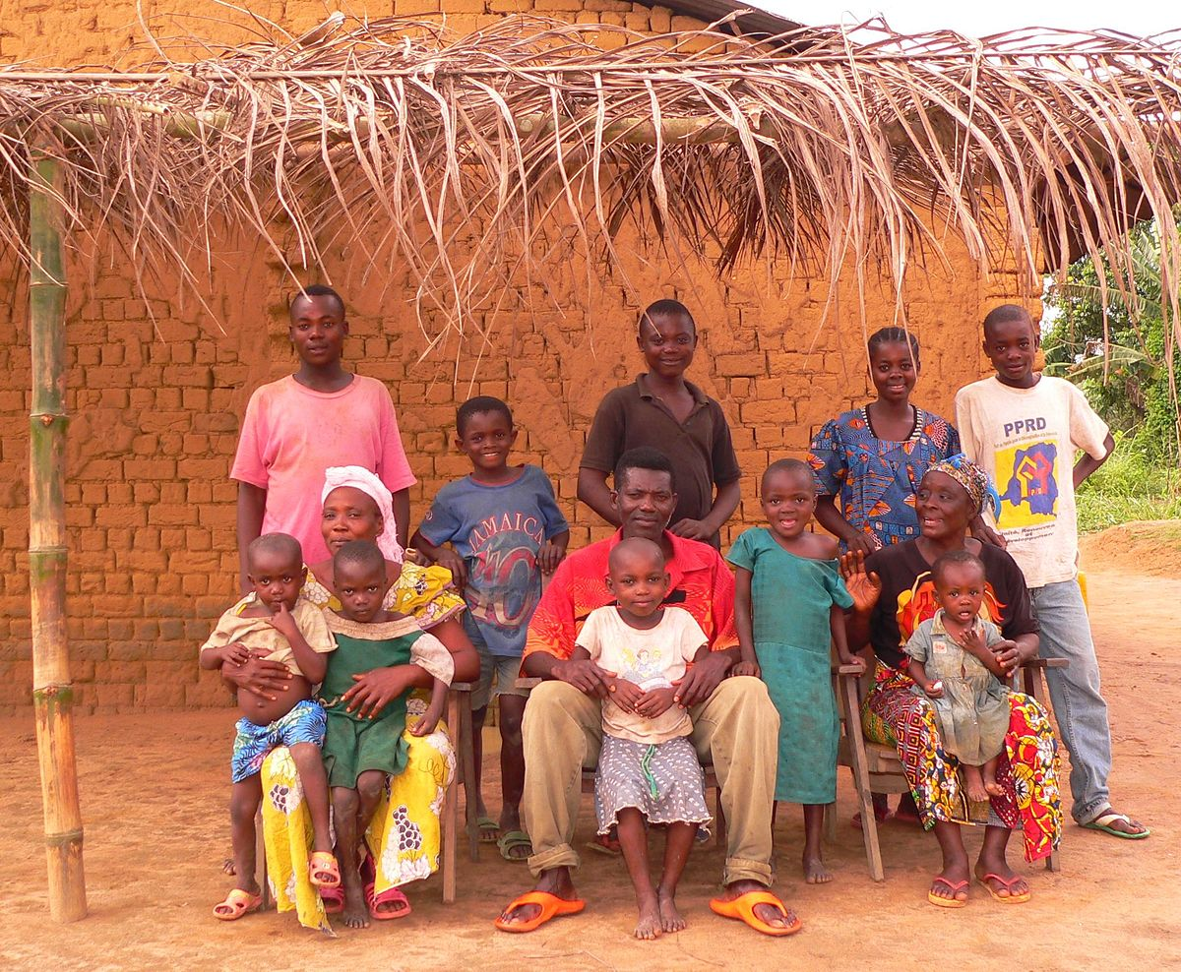
Among Congolese and other Central Africans, it is improper for men and women who don’t know each other to shake hands. Instead, they touch the backs of each others’ hands.
Imagine how this might play out during the greeting time of a worship service.
This Photo by Unknown Author is licensed under CC BY-SA

Slide 15
The word translated “hospitality” in the New Testament means “love of strangers.”
“When an alien lives with you in your land, do not mistreat him. The alien living with you must be treated as one of your native-born.
Love him as yourself, for you were aliens in Egypt.”
Leviticus 19:33-34

Slide 16
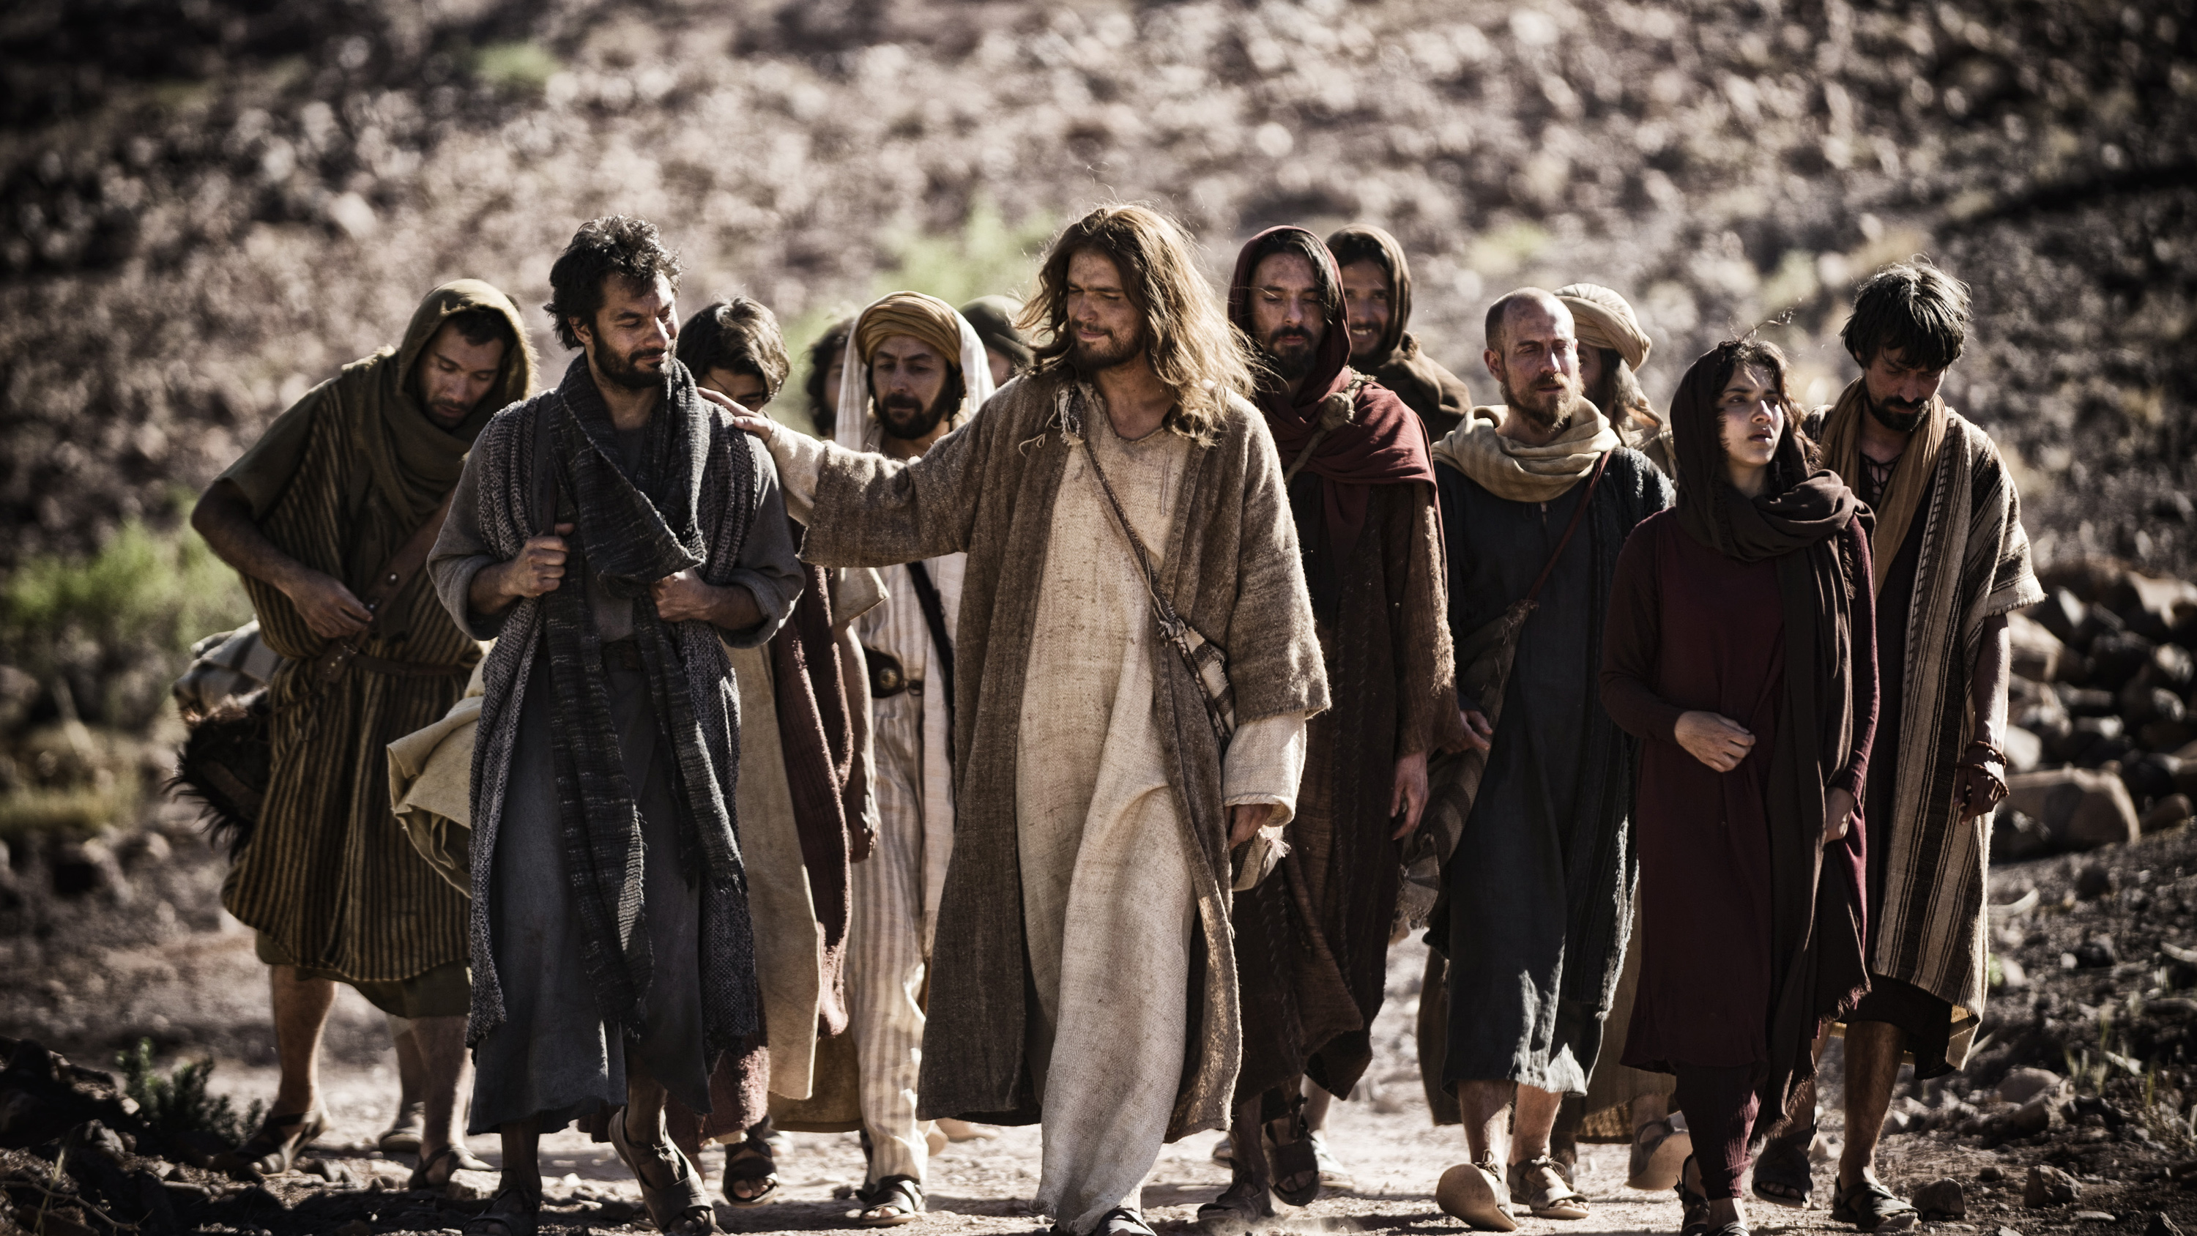
“Don’t take any money in your money belts—no gold, silver, or even copper coins.
”Don’t carry a traveler’s bag with a change of clothes and sandals or even a walking stick. Don’t hesitate to accept hospitality, because those who work deserve to be fed.”
Matthew 10:9-10 NLT
This Photo by Unknown Author is licensed under CC BY-SA

Slide 17
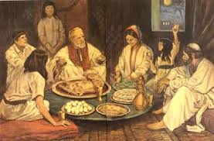
“And all the believers met together in one place and shared everything they had. They sold their property and possessions and shared the money with those in need.”
Acts 2:44-45 NLT

Slide 18
One of the requirements of a church leader:
“He must enjoy having guests in his home.”
Titus 1:8 NLT

Slide 19
“Don’t forget to show hospitality to strangers, for some who have done this have entertained angels without realizing it!” Hebrews 13:2 NLT

Slide 20
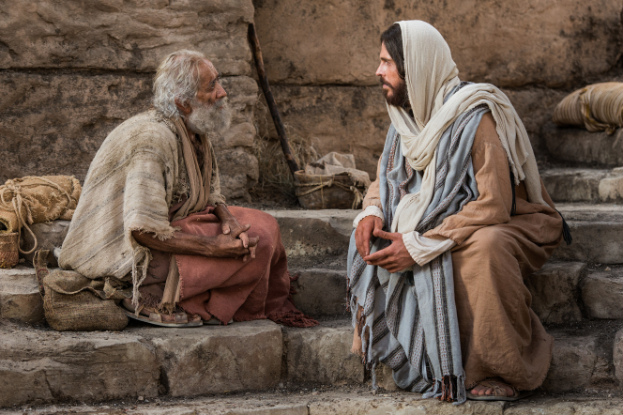
As Jesus said, ¹³ Instead, invite the poor, the crippled, the lame, and the blind.
¹⁴ Then at the resurrection of the righteous, God will reward you for inviting those who could not repay you.”
Luke 14:13-14 NLT

Slide 21
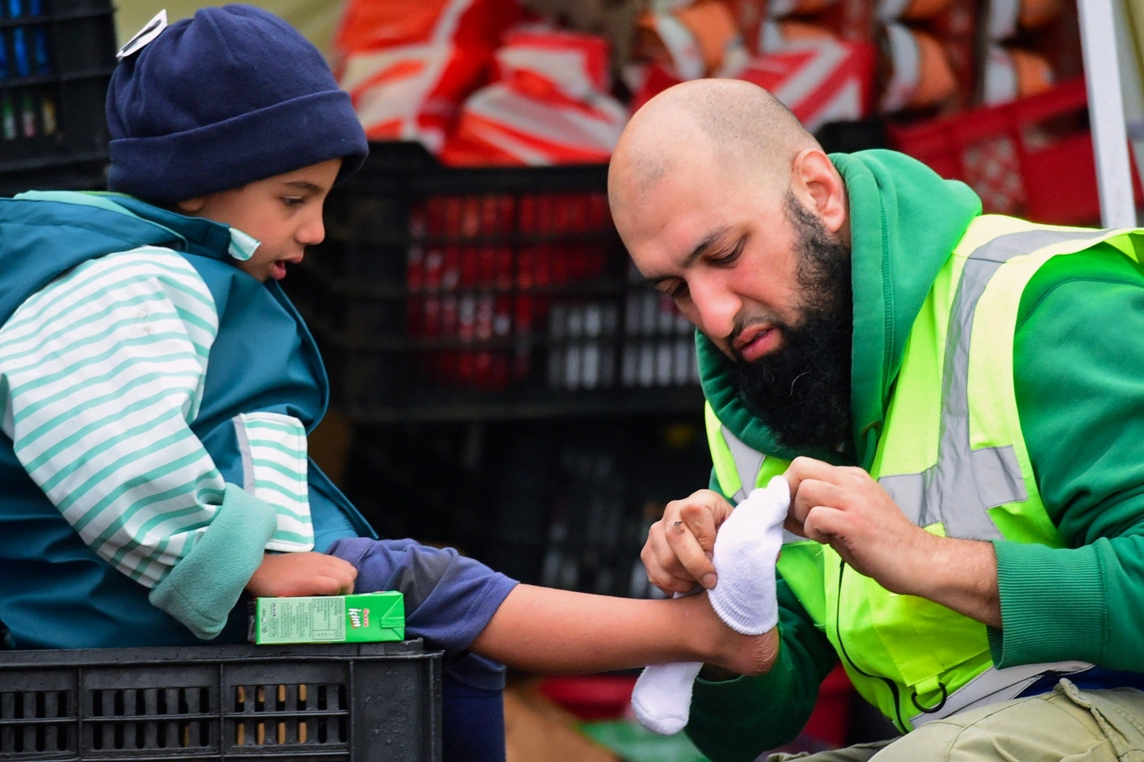
34 “Then the King will say to those on his right, ‘Come, you who are blessed by my Father, inherit the Kingdom prepared for you from the creation of the world.
35 For I was hungry, and you fed me. I was thirsty, and you gave me a drink. I was a stranger, and you invited me into your home.
36 I was naked, and you gave me clothing. I was sick, and you cared for me. I was in prison, and you visited me.’
Mathew 25:34-36 NLT

Slide 22
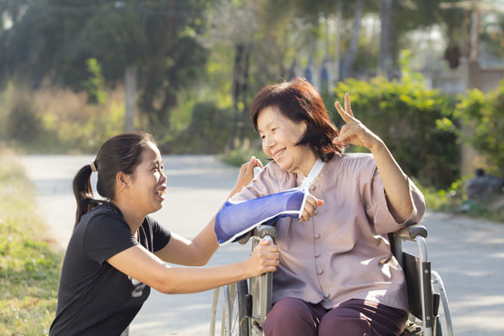
“And the King will say, ‘I tell you the truth, when you did it to one of the least of these my brothers and sisters, you were doing it to me!’
Matthew 25:40 NLT

Slide 23
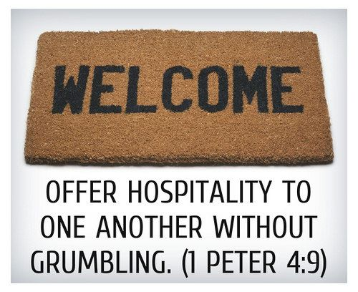

Slide 24
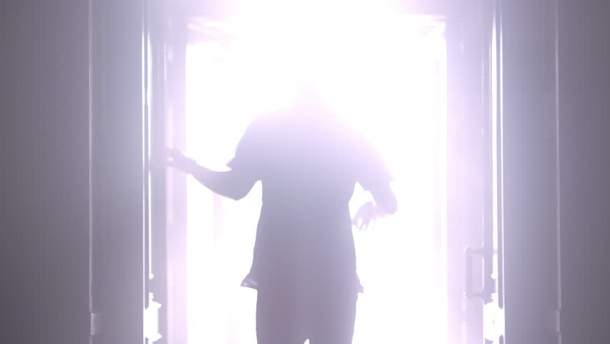
Our Goal
No one leaves Hilltop Church without making a friend.*
*Someone who knows your name and is delighted to see you when you come back.

Slide 25
Romans 15:5–6
“May the God of endurance and encouragement grant you to live in such harmony with one another, in accord with Christ Jesus, that together you may with one voice glorify the God and Father of our Lord Jesus Christ.”

