Slide 1
How to Read a Psalm

Slide 2
How were the psalms used?
Psalm 122
A song of ascents. Of David.
¹ I rejoiced with those who said to me, “Let us go to the house of the Lord.” ² Our feet are standing in your gates, Jerusalem.
³ Jerusalem is built like a city that is closely compacted together. ⁴ That is where the tribes go up— the tribes of the Lord— to praise the name of the Lord according to the statute given to Israel.
Superscription
Ascent psalms:
120-134
“Of David” can mean:
By David
To David
In relation to David
In behalf of David
Belong to David
(Part of David’s
collection)

Slide 3
Three Pilgrimage Festivals
“Three times a year all your men must appear before the Lord your God at the place he will choose: at the Festival of Unleavened Bread, the Festival of Weeks and the Festival of Tabernacles. No one should appear before the Lord empty-handed.”
--Deuteronomy 16:16 NIV

Slide 4
Psalm 100 NLT
How might this have been used in worship?
A psalm. For giving grateful praise.
¹ Shout for joy to the Lord, all the earth. ² Worship the Lord with gladness; come before him with joyful songs. ³ Know that the Lord is God. It is he who made us, and we are his; we are his people, the sheep of his pasture.
⁴ Enter his gates with thanksgiving and his courts with praise; give thanks to him and praise his name. ⁵ For the Lord is good and his love endures forever; his faithfulness continues through all generations.

Slide 5
Psalm 100 NLT
Used in a service,
perhaps a festival,
during a procession into the Temple.
A psalm. For giving grateful praise.
¹ Shout for joy to the Lord, all the earth. ² Worship the Lord with gladness; come before him with joyful songs. ³ Know that the Lord is God. It is he who made us, and we are his^{[a]}; we are his people, the sheep of his pasture.
⁴ Enter his gates with thanksgiving and his courts with praise; give thanks to him and praise his name. ⁵ For the Lord is good and his love endures forever; his faithfulness continues through all generations.

Slide 6
Psalm 54:6-7 NLT
⁶ I will sacrifice a freewill offering to you; I will praise your name, Lord, for it is good. ⁷ You have delivered me from all my troubles, and my eyes have looked in triumph on my foes.
How might this psalm have been used
in worship?

Slide 7
Individual and Community Laments
Psalm 51
¹ Have mercy on me, O God, because of your unfailing love. Because of your great compassion, blot out the stain of my sins. ² Wash me clean from my guilt. Purify me from my sin. ³ For I recognize my rebellion; it haunts me day and night. ⁴ Against you, and you alone, have I sinned;
Psalm 53
¹ Only fools say in their hearts, “There is no God.” They are corrupt, and their actions are evil; not one of them does good!
² God looks down from heaven on the entire human race; he looks to see if anyone is truly wise, if anyone seeks God. ³ But no, all have turned away; all have become corrupt.^{[b]} No one does good, not a single one!

Slide 8
Parallelism
Hebrew poetry does not rhyme.
Psalm 8:4 NLT
“What are mere mortals that you should think about them,
human beings that you should care for them?
Psalm 19:1 NLT
The heavens declare the glory of God; the skies proclaim the work of his hands.
The second line repeats and enhances the idea of the first—synonymous parallelism.

Slide 9
Antithetic parallelism
Psalm 37:9 NLT
For the wicked will be destroyed, but those who trust in the Lord will possess the land.
Psalm 1:6 NLT
For the Lord watches over the path of the godly, but the path of the wicked leads to destruction.
The second line completes a thought
by presenting a contrast with the first line.

Slide 10
Stair-step parallelism
Psalm 95:3 NLT
For the Lord is a great God, a great King above all gods.
The second line continues the thought of the first line and takes it a step further.

Slide 11
Matthew 7:7-11 NIV
7 “Ask and it will be given to you; seek and you will find; knock and the door will be opened to you.
8 For everyone who asks receives; the one who seeks finds; and to the one who knocks, the door will be opened.
9 “Which of you, if your son asks for bread, will give him a stone?
10 Or if he asks for a fish, will give him a snake?
11 If you, then, though you are evil, know how to give good gifts to your children, how much more will your Father in heaven give good gifts to those who ask him!

Slide 12
The Superscription
Psalm 12
For the choir director:
A psalm of David,
to be accompanied by an eight-stringed instrument. (Hebrew according to the sheminith.)

Slide 13
Psalm 12 NLT
¹ Help, O Lord, for the godly are fast disappearing! The faithful have vanished from the earth! ² Neighbors lie to each other, speaking with flattering lips and deceitful hearts. ³ May the Lord cut off their flattering lips and silence their boastful tongues. ⁴ They say, “We will lie to our hearts’ content. Our lips are our own—who can stop us?”
⁵ The Lord replies, “I have seen violence done to the helpless, and I have heard the groans of the poor.
Now I will rise up to rescue them, as they have longed for me to do.” ⁶ The Lord’s promises are pure, like silver refined in a furnace, purified seven times over. ⁷ Therefore, Lord, we know you will protect the oppressed, preserving them forever from this lying generation, ⁸ even though the wicked strut about, and evil is praised throughout the land.
Complaint
God’s response
People’s response

Slide 14
Psalm 12 NLT
¹ Help, O Lord, for the godly are fast disappearing! The faithful have vanished from the earth! ² Neighbors lie to each other, speaking with flattering lips and deceitful hearts. ³ May the Lord cut off their flattering lips and silence their boastful tongues. ⁴ They say, “We will lie to our hearts’ content. Our lips are our own—who can stop us?”

Slide 15
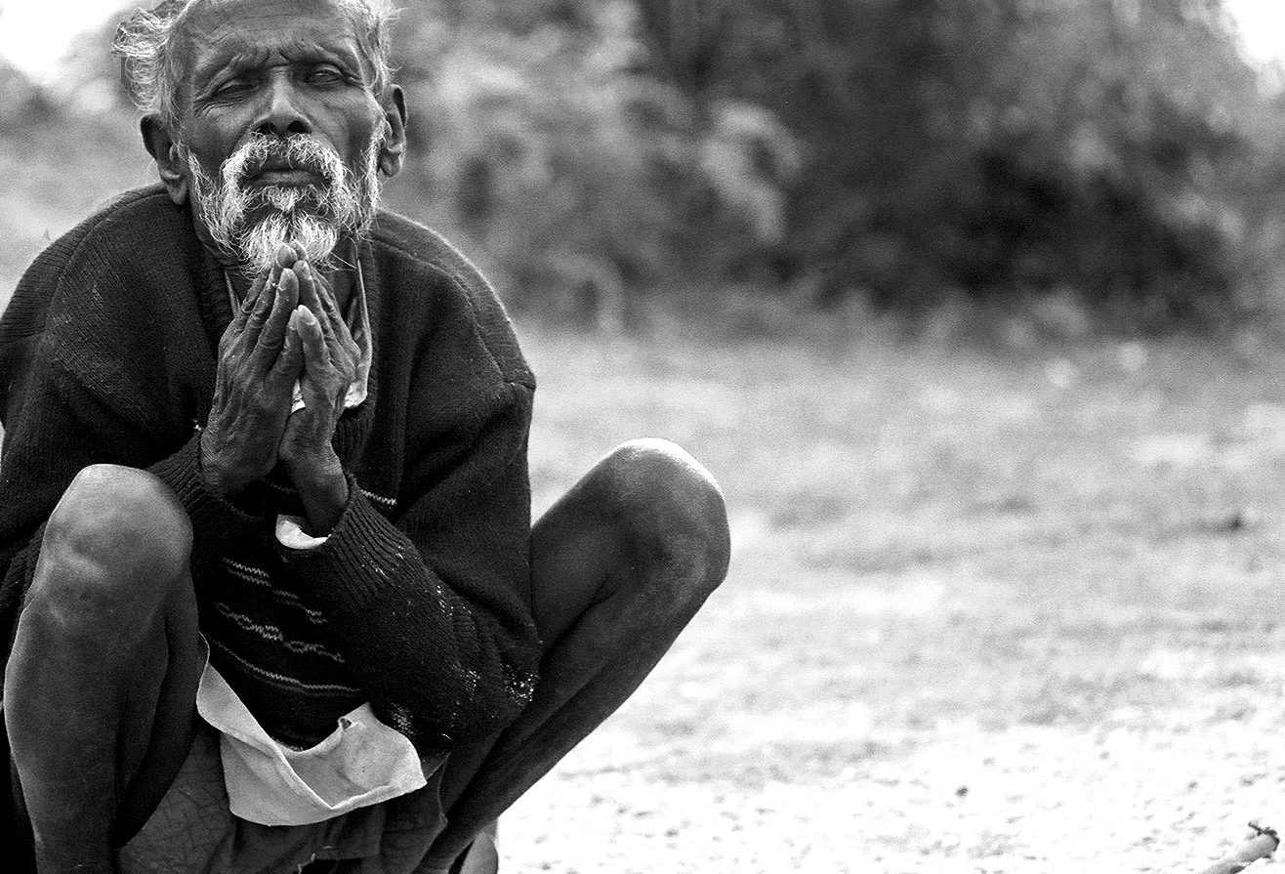
⁵ The Lord replies, “I have seen violence done to the helpless, and I have heard the groans of the poor. Now I will rise up to rescue them, as they have longed for me to do.”

Slide 16
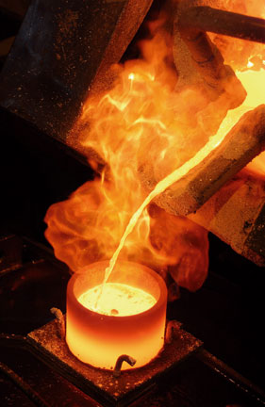
⁶ The Lord’s promises are pure, like silver refined in a furnace, purified seven times over. ⁷ Therefore, Lord, we know you will protect the oppressed, preserving them forever from this lying generation, ⁸ even though the wicked strut about, and evil is praised throughout the land.

