Slide 1
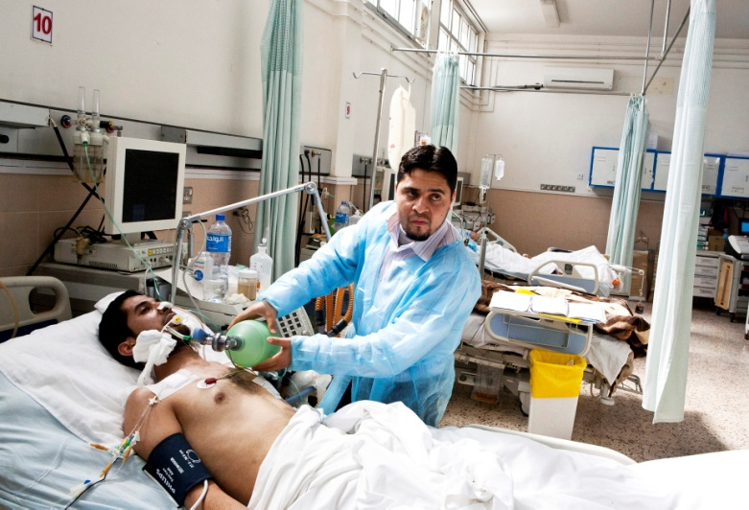
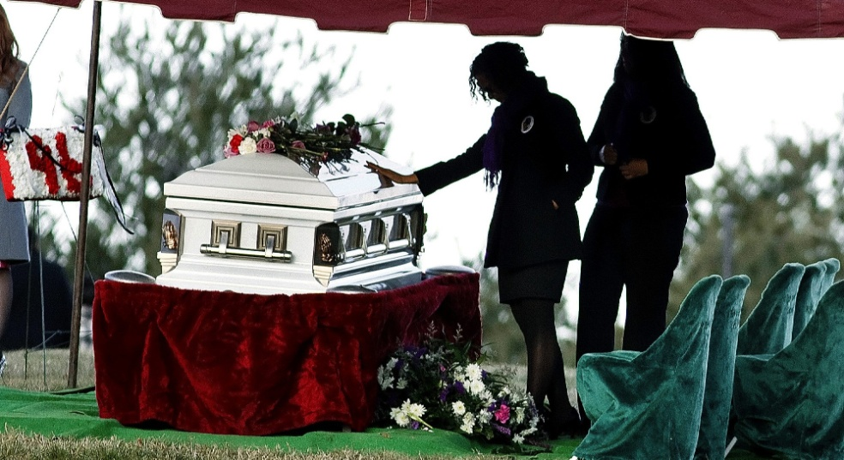
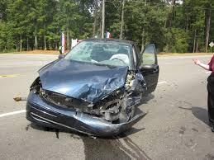

Slide 2
Resentment
(when sinned against)
Fear
(of death & suffering)
PRIDE
Worry
Holier-than -thou
Arguing
Negative
Thinking
Discontentment

Slide 4
Philippians 2:14 niv
Do
EVERYTHING
without
COMPLAINING
and
ARGUING.

Slide 5
What one thing
do you want
more than anything else?

Slide 7
#6
Arguing

Slide 8
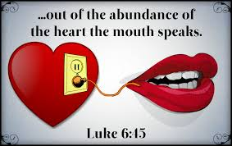

Slide 9
What one thing
did Jesus want
more than anything else?
“My food is to do the will of him who sent me
and to finish his work.”
--John 4:34 NIV
“I do not seek My own will,
but the will of Him who sent Me.”
--John 5:30 NASB

Slide 10
What does Jesus say
we should want
more than anything else?

Slide 12
Matthew 6:32 GWT
My
Needs
Everyone is concerned about these things, and your heavenly Father certainly knows you need all of them.

Slide 13
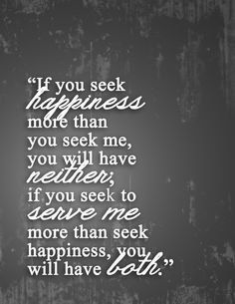
Matthew 16:25 NLT
“If you try to hang on to your life, you will lose it. But if you give up your life for my sake, you will save it.”
There are many good things
we can want—family, healing, security, being loved, etc. If we make any of these most important, that is idolatry.

Slide 14
Where does arguing come from?
Fear
Trying to control
Feeling threatened
Need to be right, “win”
“The Lord's servant must not quarrel; instead, he must be kind to everyone, able to teach, not resentful. Those who oppose him he must gently instruct, in the hope that God will give them a change of heart leading to a knowledge of the truth.”
--2 Timothy 2:24-26
When I argue, I show
that I am not trusting
God with the situation.

Slide 15
Works of the flesh
Galatians 5:19-21 NLT
Fruits of the spirit
Galatians 5:22-23 NLT
“When you follow the desires of your sinful nature, the results are very clear:
sexual immorality,
impurity,
lustful pleasures,
idolatry,
sorcery,
hostility,
quarreling,
jealousy,
outbursts of anger,
selfish ambition,
dissension,
division,
envy,
drunkenness,
wild parties, and other sins like these.
Let me tell you again, as I have before, that anyone living that sort of life will not inherit the Kingdom of God.”
“But the Holy Spirit produces this kind of fruit in our lives:
love,
joy,
peace,
patience,
kindness,
goodness,
faithfulness,
gentleness,
and self-control.
There is no law against these things!”
”Those who belong to Christ Jesus have nailed the passions and desires of their sinful nature to his cross and crucified them there” (Galatians 5:24).

Slide 16
Speech filters
Foul/abusive language? Or encouraging words?
“Don't use foul or abusive language. Let everything you say be good and helpful, so that your words will be an encouragement to those who hear them.” (Eph. 4:29, NLT)
Do my words bring glory to God?
“So whether you eat or drink, or whatever you do, do it all for the glory of God” (1 Cor. 10:31).
Am I arguing or complaining (whining)?
“Do everything without complaining and arguing” (Phil 2:14).

Slide 17
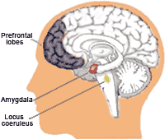
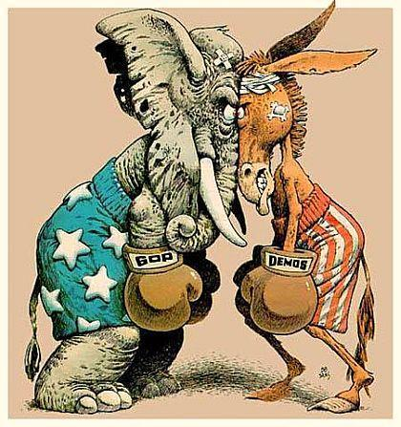
Speak the truth in love
Survival mode vs. learning mode

Slide 18
Arguing
Ask God to eliminate this joy-killer from your life.
Ask God to show you what is happening in your heart
that comes out as arguing. Repent of it and ask
God to remove it.
Commit to learn the skills to deal with conflict
without arguing.

Slide 19
Table sharing
Jesus says, “What you say flows from your heart” (Luke 6:45). Can you think of a time you argued? What do you think was in your heart that came out as arguing? (Fear? Shame? Trying to control? Feeling helpless,? Judging, Something else?)
Proverbs says, “Trust in the Lord with all your heart” (3:5). If you had been totally trusting God with the situation you argued about, would it have changed how you responded? If so, how?

