Slide 1
PSALM 132:1-12
Lord, remember David and all that he suffered. He made a solemn promise to the Lord. He vowed to the Mighty One of Israel, “I will not go home; I will not let myself rest. I will not let my eyes sleep nor close my eyelids in slumber until I find a place to build a house for the Lord, a sanctuary for the Mighty One of Israel.” We heard that the Ark was in Ephrathah; then we found it in the distant countryside of Jaar. Let us go to the sanctuary of the Lord; let us worship at the footstool of his throne. Arise, O Lord, and enter your resting place, along with the Ark, the symbol of your power. May your priests be clothed in godliness; may your loyal servants sing for joy. For the sake of your servant David, do not reject the king you have anointed. The Lord swore an oath to David with a promise he will never take back: “I will place one of your descendants on your throne. If your descendants obey the terms of my covenant and the laws that I teach them, then your royal line will continue forever and ever.”
.

Slide 2
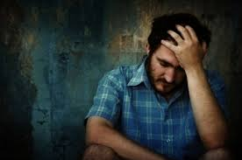
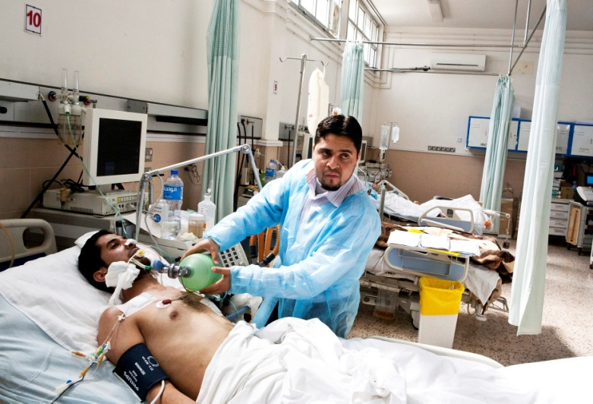
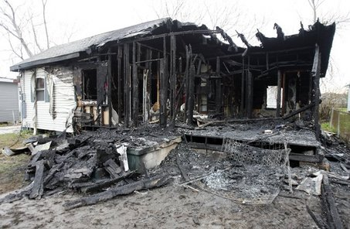
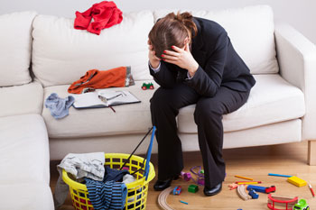
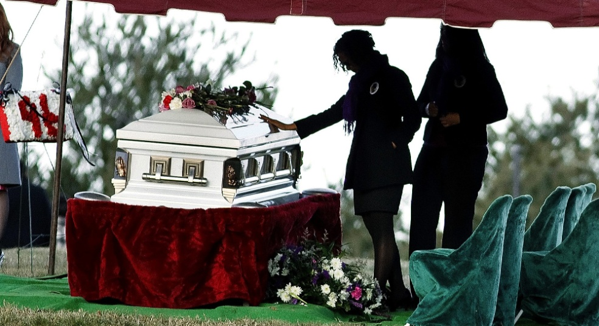
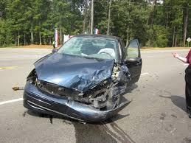

Slide 3
Resentment
(when sinned against)
Fear
(of death & suffering)
PRIDE
Worry
Holier-than -thou
Arguing
Negative
Thinking
Discontentment

Slide 5
Philippians 2:14 niv
Do
EVERYTHING
without
COMPLAINING
and
ARGUING.

Slide 6
#6
If I Only Had…

Slide 7
https://www.youtube.com/watch?v=wg66kwRnOpw

Slide 8
I would be happy if…
…I had more ___________________.
…I was more ___________________.
…I wasn’t so ___________________.
…I didn’t have to ________________.
…I could get rid of _______________.

Slide 10
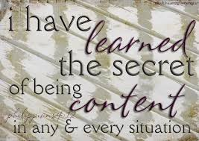
.
.
.
.
.
I have learned the secret of being content in any and every situation,

Slide 11
Philippians 4:11-12 NIV
I have learned to be content whatever the circumstances. ¹² I know what it is to be in need, and I know what it is to have plenty. I have learned the secret of being content in any and every situation, whether well fed or hungry, whether living in plenty or in want.¹³ I can do all this through him who gives me strength.

Slide 12
What is the secret?
We can never be content so long as we thing we need more to be happy.
Contentment comes not from having more but from wanting less.

Slide 13
Learning the secret
F A T
FOCUS on what you have, not what you don’t have.
“Because the Lord is my shepherd, I have everything I need..” (Psalm 23:1, TLB)
ASK God for what you need.
“Don’t worry about anything. Instead, pray about everything. Tell God your needs…
THANK God for his answers.
…and don’t forget to thank him for his answers.” (Philippians 4:6-7, TLB)

Slide 14
PHILIPPIANS 4:6-7, tlb
⁶ Don’t worry about anything; instead, pray about everything; tell God your needs, and don’t forget to thank him for his answers. ⁷ If you do this, you will experience God’s peace, which is far more wonderful than the human mind can understand. His peace will keep your thoughts and your hearts quiet and at rest as you trust in Christ Jesus.

Slide 15
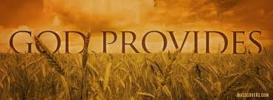
“And this same God who takes care of me will supply all your needs from his glorious riches, which have been given to us in Christ Jesus.”
--Philippians 4:19 NLT

Slide 16
Learning the secret
F A T
FOCUS on_________________,
not_______________.
ASK __________________.
THANK _____________________.

Slide 17
Learning the secret
F A T
FOCUS
ASK
THANK

Slide 18
Table sharing
Which do you focus on more—being thankful for what you have or concern about what you don’t have?
How can you be joyful when you have a real need and don’t see how it will be met?

