Slide 1
Not So With You
Matthew 20:17-25
Ephesians 5:15-21

Slide 2
Matthew 20:17-28
¹⁷⁻¹⁹ Jesus, now well on the way up to Jerusalem, took the Twelve off to the side of the road and said, “Listen to me carefully. We are on our way up to Jerusalem. When we get there, the Son of Man will be betrayed to the religious leaders and scholars. They will sentence him to death. They will then hand him over to the Romans for mockery and torture and crucifixion. On the third day he will be raised up alive.”

Slide 3
Matthew 20:17-28
²⁰ It was about that time that the mother of the Zebedee brothers came with her two sons and knelt before Jesus with a request.
²¹ “What do you want?” Jesus asked.

Slide 4
Matthew 20:17-28
She said, “Give your word that these two sons of mine will be awarded the highest places of honor in your kingdom, one at your right hand, one at your left hand.”
²² Jesus responded, “You have no idea what you’re asking.” And he said to James and John, “Are you capable of drinking the cup that I’m about to drink?”
They said, “Sure, why not?”

Slide 5
Matthew 20:17-28
Jesus said, “Come to think of it, you are going to drink my cup. But as to awarding places of honor, that’s not my business. My Father is taking care of that.”
²⁴⁻²⁸ When the ten others heard about this, they lost their tempers, thoroughly disgusted with the two brothers. So Jesus got them together to settle things down.

Slide 6
Matthew 20:17-28
He said, “You’ve observed how godless rulers throw their weight around, how quickly a little power goes to their heads. It’s not going to be that way with you.
NOT SO WITH YOU

Slide 7
Matthew 20:17-28
Whoever wants to be great must become a servant. Whoever wants to be first among you must be your slave. That is what the Son of Man has done: He came to serve, not be served—and then to give away his life in exchange for the many who are held hostage.

Slide 8
Submit to one another . . .
Who is our model for submission?

Slide 9
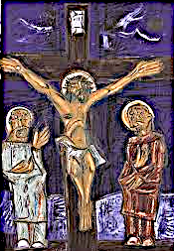
1352 × 1920

Slide 10
Submit to one another . . .
How do we practice?

Slide 11
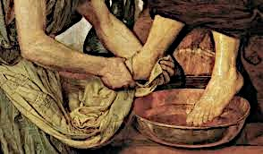
550 × 322

Slide 12
Submit to one another . . .
How do we practice?

Slide 13
Submit to one another . . .
Through worship.
We become friends because we have good work to do, worship.

Slide 14
Ephesians 5:18-21
Instead, be filled with the Spirit, ¹⁹ speaking to one another with psalms, hymns, and songs from the Spirit. Sing and make music from your heart to the Lord, ²⁰ always giving thanks to God the Father for everything, in the name of our Lord Jesus Christ.
²¹ Submit to one another out of reverence for Christ.

Slide 15
Submission
First, it is a state of the heart.
It cannot be taken from you.
It can only be given.
Submission is one way of dying to self – Mark 8.

Slide 16
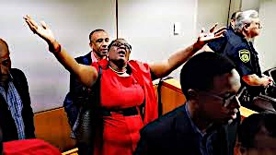
3 days ago
1200 × 675

Slide 17
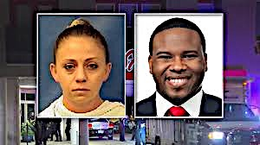
1920× 1080
3 days ago
1200 × 675

Slide 18
Submit to one another . . .
We submit to one another stories.
We listen and we hear.
We withhold judgment.

