Slide 1
Tired in body and spirit?
Uncertain, needing direction?
Oppressed by darkness?
Needing comfort, guidance, & protection?
Under attack? Threatened?
In need of healing? Power?
Running on empty?
Feeling insignificant?

Slide 2
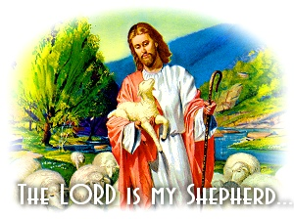
Because
I have everything I need.

Slide 3
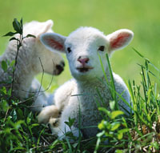
He makes me lie down in green pastures.

Slide 4
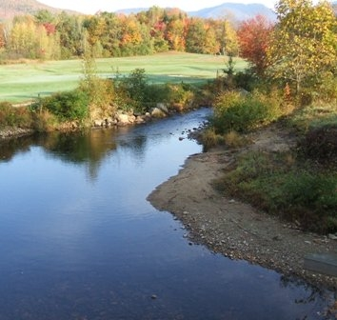
He leads me beside quiet waters.
He restores my soul.

Slide 5
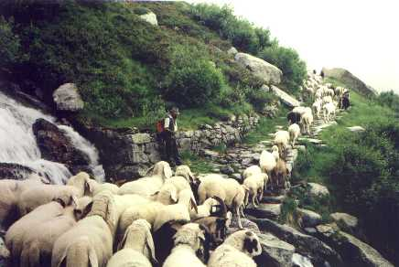
He leads me along right paths
to bring honor to his name.

Slide 6
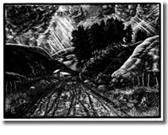
Even though I walk through the darkest valley,
I will fear no evil,
for you are with me.

Slide 7
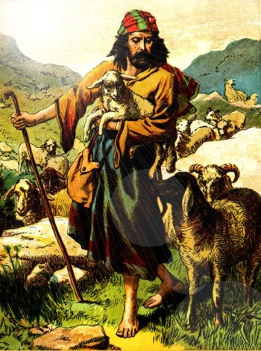
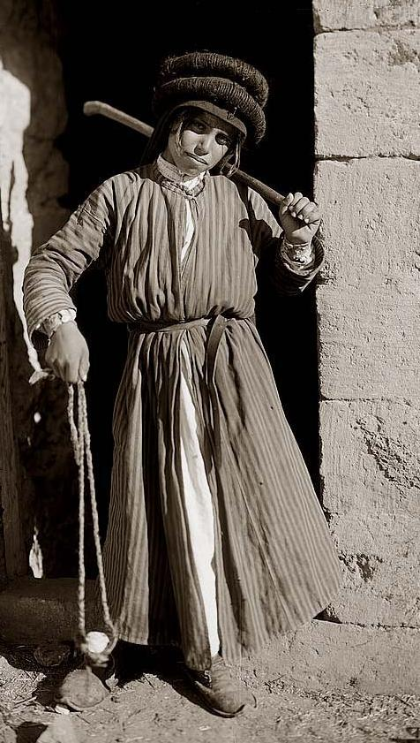
Your rod and your staff,
they comfort me.

Slide 8
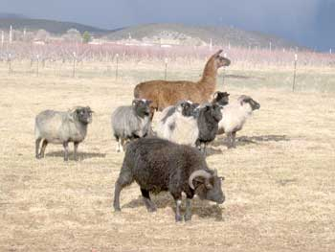
You prepare a table for me
in the presences of my enemies.
Sheep on Rogers Mesa in Iceland

Slide 9
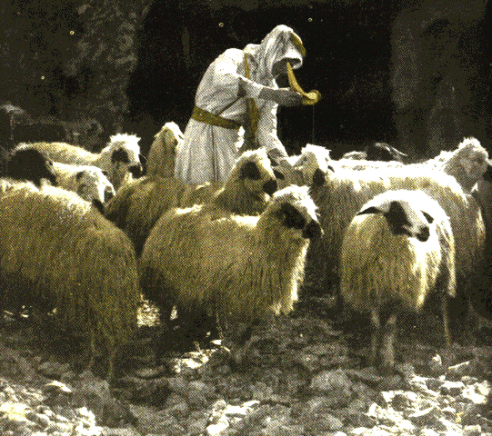
You anoint my head
with oil.

Slide 10
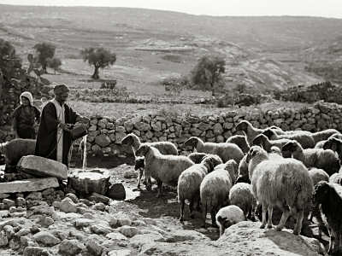
My cup overflows.

Slide 11
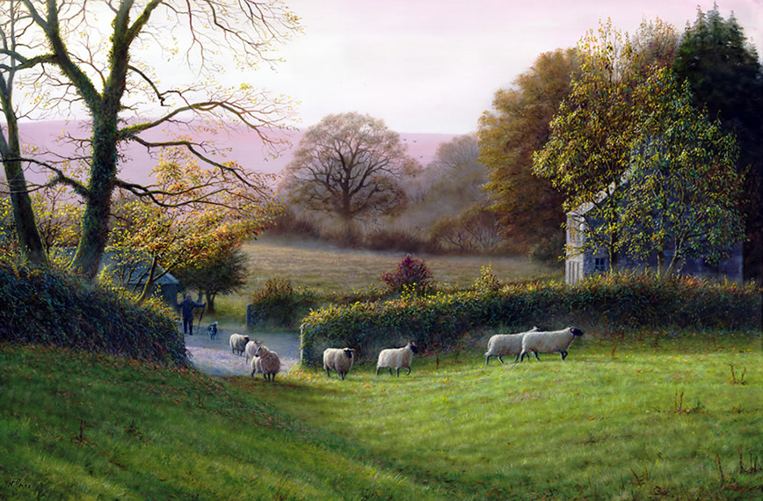
Surely goodness and mercy shall follow me
all the days of my life.

Slide 12
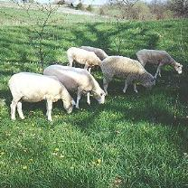
And I will return
to the house of the Lord
again and again.

Slide 13
Tired in body and spirit?
Uncertain, needing direction?
Oppressed by darkness?
Needing comfort, guidance, & protection?
Under attack? Threatened?
In need of healing? Power?
Running on empty?
Feeling insignificant?

