Slide 1
How to Be
a Safe Person
Safety-Killer:
Trying to Control Others
Ephesians 4:29

Slide 2
One of Our Core Values…..
Be a church that is
great at relationships.

Slide 3
Six Safety Killers
Gossip
Defensiveness
Blame
Judging motives
Taking offense
Control

Slide 4
Ephesians 4:29 NIV
Let no unwholesome talk come out of your mouths,
but only what is helpful for building others up.

Slide 5
Ephesians 4:29 NIV
Let no unwholesome talk…
but only what is helpful…

Slide 6
Ephesians 4:29 NIV
Let no…
but only…

Slide 7
SAFETY-KILLER
SAFETY-BUILDER
CONTROL.
I try to get others to change how they think, feel, and act.
“WE ADMITTED WE WERE POWERLESS OVER …

Slide 8
SAFETY-KILLER
SAFETY-BUILDER
CONTROL.
I try to get others to change how they think, feel, and act.
“WE ADMITTED WE WERE POWERLESS OVER OTHERS.”
I commit to becoming free of the “deadly habits of control” including criticizing, complaining, nagging, threatening, and appeasing to manage others’ feelings. I learn to set healthy boundaries and let others take responsibility for their choices and emotions.

Slide 9
Matthew 20:25-26 ESV
But Jesus called them to him and said, “You know that the rulers of the Gentiles lord it over them, and their great ones exercise authority over them. It shall not be so among you. But whoever would be great among you must be your servant.

Slide 10
James 3:13-17 NIV
¹³ Who is wise and understanding among you? Let them show it by their good life, by deeds done in the humility that comes from wisdom. ¹⁴ But if you harbor bitter envy and selfish ambition in your hearts, do not boast about it or deny the truth. ¹⁵ Such “wisdom” does not come down from heaven but is earthly, unspiritual, demonic. ¹⁶ For where you have envy and selfish ambition, there you find disorder and every evil practice.
¹⁷ But the wisdom that comes from heaven is first of all pure; then peace-loving, considerate, submissive, full of mercy and good fruit, impartial and sincere.

Slide 12
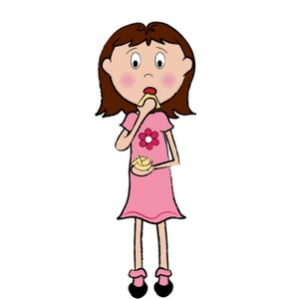
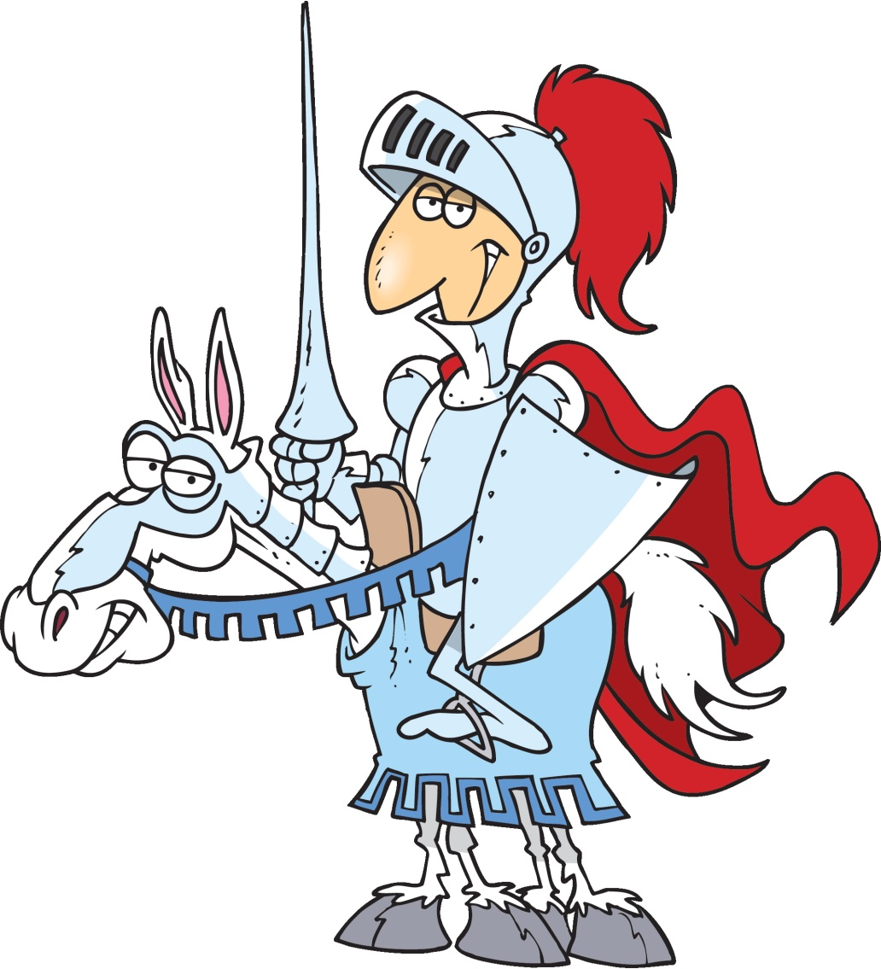
Looking for somebody
to rescue me (& run my life)
Looking for somebody to
rescue (& to run her life)

Slide 13
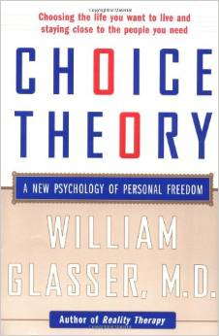
A book that changed my life
Lies of “external control psychology”
I can make other people do what I
want them to do even if they don’t
want to do it.
Other people can control how I think, act, and feel.
p. 16

Slide 14
“It is hard…to love someone who wants to control and change you or someone you want to control and change.”
Choice Theory, p. 35

Slide 15
What are some of the things we do to try to control others?
Complaining
Criticizing
Nagging
Threatening
Appeasing (to manage others’ emotions”
Quarreling

Slide 16
Why do we use “the deadly habits of control”?
Because they work. Sometimes we can get other people to do to what we want.
The price? We can’t have the safe, healthy relationships we need and long for.
A relationship where one person is trying to control the other is not healthy.
Control is a counterfeit for feeling loved.
Like pornography, at first it feels like intimacy, but it doesn’t satisfy our hearts.

Slide 17
Philippians 2:14-15 NLT
¹⁴ Do everything without complaining and arguing,
¹⁵ so that no one can criticize you. Live clean, innocent lives as children of God, shining like bright lights in a world full of crooked and perverse people.

Slide 18
1 Timothy 3:3
The qualifications for church leaders (elders) include that they must be:
“gentle” and
“not quarrelsome.”

Slide 19
2 Timothy 2:24-25 NIV
And the Lord's servant must not quarrel; instead, he must be kind to everyone, able to teach, not resentful.
Those who oppose him he must gently instruct, in the hope that God will grant them repentance leading them to a knowledge of the truth.
What does this look like?

Slide 20
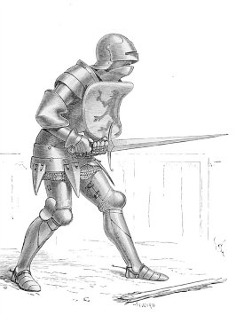
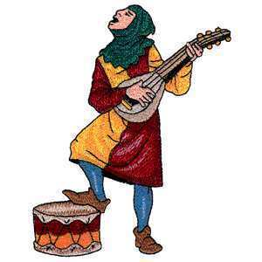
The Knight & the Minstrel

Slide 21
“Sing a song that reminds people of who I created them to be.”

Slide 22
Table Sharing
1. Which of the “Deadly Habits of Control” are the greatest challenge for you?
Complaining
Criticizing
Nagging
Threatening
Appeasing (to manage others’ emotions”
Quarreling
2. Is there something you would like to learn to do differently in this are to become a safer person?

