Slide 1
Total Praise
Allysa Hupko- Wildfire Ministries

Slide 2
Rise and Shine
Rise and Shine and Give God the Glory
Rise and Shine and Give God the Glory
Rise and Shine and Give God the Glory, Glory
Children of the Lord

Slide 3
What is Praise ?
To express warm approval or admiration of
To express warm approval or admiration for someone or something.
To express a favorable judgement of command: To glorify God especially by the attribution of perfection : to express praise

Slide 4
What is Praise?
WE were created to bless him
Praise is a weapon
Sacrifice
Psalm 149:6
Psalm 144:1
Psalm 103: 1-6
Psalm 33:1
Hebrews 13:15

Slide 5
Effective PRAISE
Positive
Reinforces High Expectations
Appropriate
Independence Is Promoted
Sincere
Effort and Progress Are Noted

Slide 6
The Mindset of Praise
Psalm 100:4
Congregation: Enter into his gates with thanksgiving
Reader: and enter into his courts with praise:
Congregation: be thankful unto him, and bless his holy name
This Photo by Unknown Author is licensed under CC BY-NC-SA

Slide 7
Why should I Praise the Lord?
Is it because I feel like it?
What if I never have experienced his presence or goodness?
What if I am unable to physically praise him?
What if I am mad?

Slide 8
Psalm 103: 1-6, 11-19
Psalm 103 Of David.
1
Praise the LORD, O my soul; all my inmost being, praise his holy name.
2
Praise the LORD, O my soul, and forget not all his benefits--
3
who forgives all your sins and heals all your diseases,
4
who redeems your life from the pit and crowns you with love and compassion,
5
who satisfies your desires with good things so that your youth is renewed like the eagle's.
6
The LORD works righteousness and justice for all the oppressed.

Slide 9
Psalm 103: 1-7, 11-19
For as high as the heavens are above the earth, so great is his love for those who fear him;
12
as far as the east is from the west, so far has he removed our transgressions from us.
13
As a father has compassion on his children, so the LORD has compassion on those who fear him;
14
for he knows how we are formed, he remembers that we are dust.
15
As for man, his days are like grass, he flourishes like a flower of the field;
16
the wind blows over it and it is gone, and its place remembers it no more.
17
But from everlasting to everlasting the LORD's love is with those who fear him, and his righteousness with their children's children--
18
with those who keep his covenant and remember to obey his precepts.
19
The LORD has established his throne in heaven, and his kingdom rules over all.

Slide 10
How do I bless the Lord with my soul?
Soul= Mind, Will, Emotions, and all Reasoning
This Photo by Unknown Author is licensed under CC BY-SA

Slide 11
Praise
Clapping
Writing
Singing
Dancing
Painting
Playing Instruments
Shouting

Slide 12
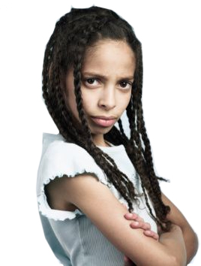
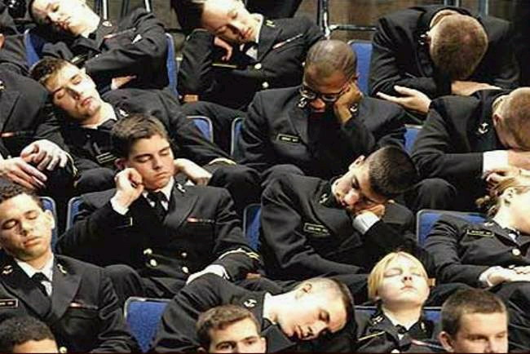
Examples of What Praise is NOT
This Photo by Unknown Author is licensed under CC BY-NC-ND
This Photo by Unknown Author is licensed under CC BY-SA

Slide 13
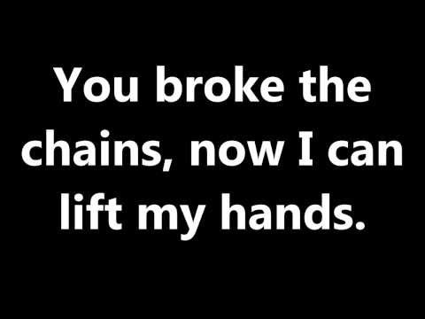
Active Your Praise!!!!!!!

Slide 14
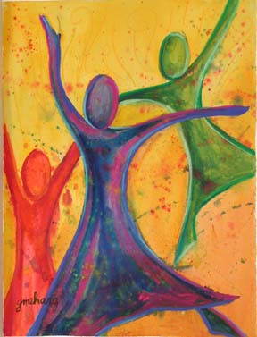
Focus Questions
1. What is the proper mindset of praise?
2. What are some things that God has done to prove that he is worthy to receive praise
3. What is the soul made up of?
This Photo by Unknown Author is licensed under CC BY-NC

Slide 15
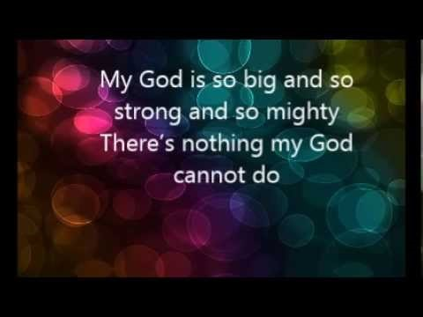
Praise is commonly for the upright!!!
This Photo by Unknown Author is licensed under CC BY-NC-SA

