Slide 1
Psalms of Praise

Slide 2
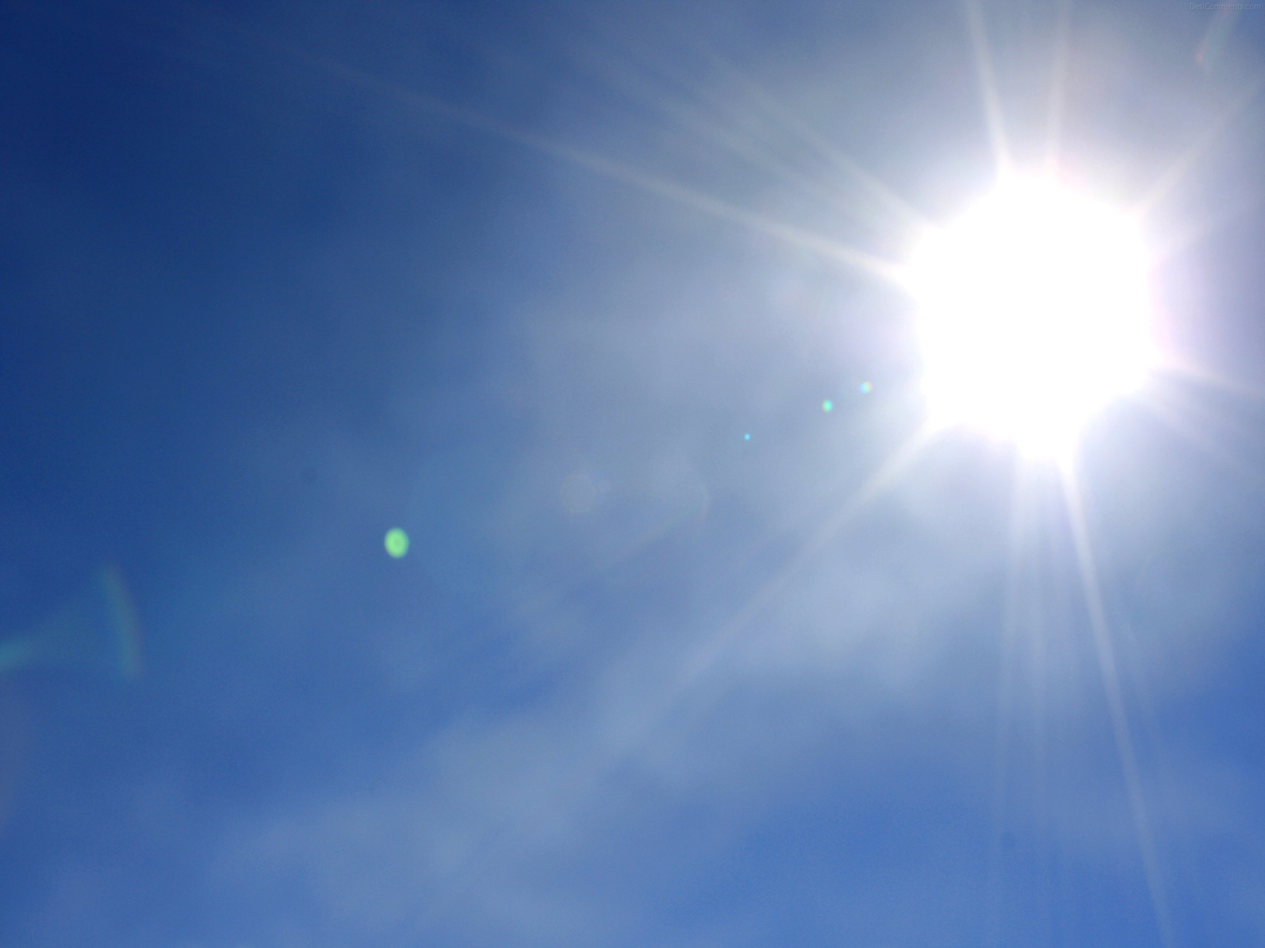
Proverbs 11:30b VOICE
“Whoever wins souls is wise.”
Psalm 116:15 VOICE
“Precious in the eyes of the Eternal are the deaths of those who follow after Him.”

Slide 3
Psalm 145 VOICE
A psalm of praise by David
¹ I will lift my praise above everything to You, my God and King! I will continually bless Your name forever and always.

Slide 4
² ² My praise will never cease—
I will praise You every day; I will lift up Your name forever.

Slide 5
³ The Eternal is great and deserves endless praise; His greatness knows no limit, recognizes no boundary. No one can measure or comprehend His magnificence.

Slide 6
⁴ One generation after another will celebrate Your great works; they will pass on the story of Your powerful acts to their children.

Slide 7
⁵ Your majesty and glorious splendor have captivated me; I will meditate on Your wonders, sing songs of Your worth.

Slide 8
⁶ We confess—there is nothing greater than You, God, nothing mightier than Your awesome works. I will tell of Your greatness as long as I have breath.

Slide 9
⁷ The news of Your rich goodness is no secret— Your people love to recall it and sing songs of joy to celebrate Your righteousness.

Slide 10
⁸ The Eternal is gracious. He shows mercy to His people. For Him anger does not come easily, but faithful love does—and it is rich and abundant.

Slide 11
⁹ But the Eternal’s goodness is not exclusive—it is offered freely to all. His mercy extends to all His creation.

Slide 12
¹⁰ All creation will stand in awe of You, O Eternal One. Thanks will pour from the mouths of every one of Your creatures; Your holy people will bless You.

Slide 13
¹¹ They will not be silent; they will talk of the grandeur of Your kingdom and celebrate the wonder of Your power

Slide 14
¹² Until everyone on earth who has ears to hear knows Your valiant acts and the splendor of Your kingdom.

Slide 15
¹³ Your kingdom will never end; Your rule will endure forever.
[You are faithful to Your promise, and Your acts are marked with grace.]

Slide 16
¹⁴ The Eternal sustains all who stumble on their way. For those who are broken down, God is near. He raises them up in hope.

Slide 17
¹⁵ All eyes have turned toward You, waiting in expectation; when they are hungry, You feed them right on time.

Slide 18
¹⁶ The desires of every living thing are met by Your open hand.

Slide 19
¹⁷ The Eternal is right in all His ways, and He is kind in all His acts.

Slide 20
¹⁸ The Eternal stays close to those who call on Him, those who pray sincerely.

Slide 21
¹⁹ All of you who revere Him— God will satisfy your desires. He hears the cries for help, and He brings salvation.

Slide 22
²⁰ All of you who love God— He will watch out for you, but total destruction is around the corner for all the wicked.

Slide 23
²¹ My lips will sing the praise of the Eternal. Let every creature join me and praise the holy name of God—forever and always!

