Slide 2
I John 2:4 NLT
If someone claims, “I know God,”
but doesn’t obey God’s commandments, that person is a liar
and is not living in the truth.

Slide 3
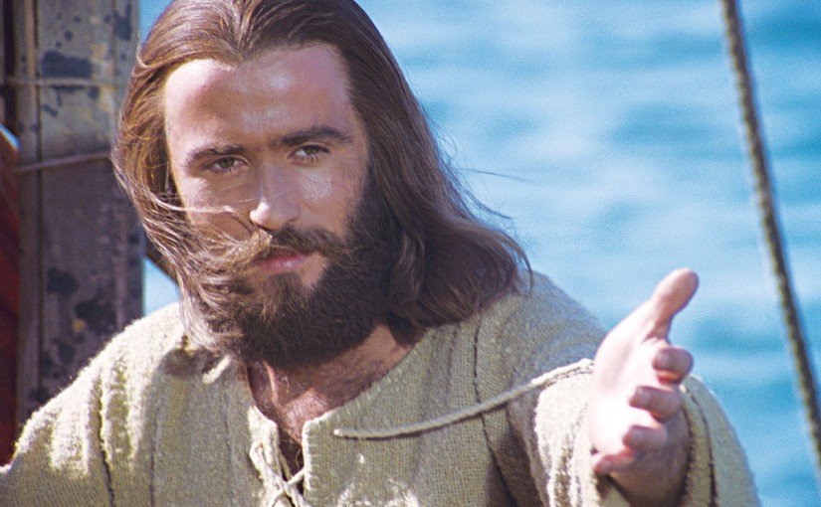
How Can I Tell if I’m a Christian?
The Test of Obedience
1 John 2:3-6;
3:4-10

Slide 4
1 John 2:3-6 NLT
³ And we can be sure that we know him if we obey his commandments. ⁴ If someone claims, “I know God,” but doesn’t obey God’s commandments, that person is a liar and is not living in the truth. ⁵ But those who obey God’s word truly show how completely they love him. That is how we know we are living in him. ⁶ Those who say they live in God should live their lives as Jesus did.

Slide 5
1 John 3:4-10 NLT
⁴ Everyone who sins is breaking God’s law, for all sin is contrary to the law of God. ⁵ And you know that Jesus came to take away our sins, and there is no sin in him. ⁶ Anyone who continues to live in him will not sin. But anyone who keeps on sinning does not know him or understand who he is.
⁷ Dear children, don’t let anyone deceive you about this: When people do what is right, it shows that they are righteous, even as Christ is righteous. ⁸ But when people keep on sinning, it shows that they belong to the devil, who has been sinning since the beginning. But the Son of God came to destroy the works of the devil. ⁹ Those who have been born into God’s family do not make a practice of sinning, because God’s life is in them. So they can’t keep on sinning, because they are children of God. ¹⁰ So now we can tell who are children of God and who are children of the devil. Anyone who does not live righteously and does not love other believers does not belong to God.

Slide 6
1 John 3:4-10 NLT
⁴ Everyone who sins is breaking God’s law, for all sin is contrary to the law of God. ⁵ And you know that Jesus came to take away our sins, and there is no sin in him. ⁶ Anyone who continues to live in him will not sin. But anyone who keeps on sinning does not know him or understand who he is.
⁷ Dear children, don’t let anyone deceive you about this: When people do what is right, it shows that they are righteous, even as Christ is righteous. ⁸ But when people keep on sinning, it shows that they belong to the devil, who has been sinning since the beginning. But the Son of God came to destroy the works of the devil. ⁹ Those who have been born into God’s family do not make a practice of sinning, because God’s life is in them. So they can’t keep on sinning, because they are children of God. ¹⁰ So now we can tell who are children of God and who are children of the devil. Anyone who does not live righteously and does not love other believers does not belong to God.

Slide 7
1 John 2:1 NLT
My dear children, I am writing this to you so that you will not sin. But if anyone does sin, we have an advocate who pleads our case before the Father. He is Jesus Christ, the one who is truly righteous.

Slide 8
How can we know we have eternal life?
Three tests
The test of obedience. “And we can be sure that we know him if we obey his commandments.” (2:3 NLT)
The test of love.
The test of correct belief about Christ.

Slide 9
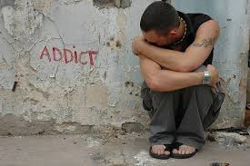
Why Does God Hate Sin?
If we love someone, and that person becomes addicted to drugs, how do we feel about the addiction? Why?
God hates sin because sin damages us, it damages our relationships and it keeps us from enjoying the abundant life he want us to have.
God hates sin because he loves us and wants the best for us.

Slide 10
John 10:10 ESV
“The thief comes only to steal and kill and destroy…
(Who is the thief?)
…I came that they may have life and have it abundantly.”

Slide 12
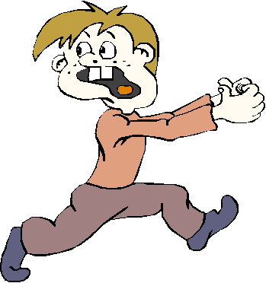
1 Corinthians 6:18
¹⁸ Run from sexual sin! No other sin so clearly affects the body as this one does. For sexual immorality is a sin against your own body.

Slide 13
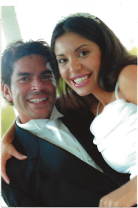
What is sexual sin?
God thinks sex is a great idea. After all, it was his idea!
His design for sex is that it is to take place only within the security of marriage. Any voluntary sex with a person you are not married to is what the Bible calls “fornication,” or sexual immorality. Lust is another form of sexual immorality.

Slide 14
What are some reasons people have sex outside of marriage?
What are some things people say to try to convince themselves it’s okay?
Why is it sometimes hard to give up sexual sin?

Slide 15
Some freeing truths that may surprise you
Sex is not a need. It is a desire.
Being married—or having a boyfriend or girlfriend—is not essential to living a full life. God calls some to marriage, others to singleness. He wants an abundant life for all of us.
No human can fill your hunger for perfect love; only God can.
If you “package” yourself to win someone’s love, you get conditional love.
The biggest key to a great relationship isn’t finding the right person, but being the right person.
If holding onto another person is more important to you than obeying God, that person has become your god. An idolatrous relationship cannot be truly healthy.

Slide 16
Whose wisdom do you trust more— Yours or God’s?
Do you believe this or not?

Slide 17
What does the Bible say about addiction?
¹² You say, “I am allowed to do anything”—but not everything is good for you. And even though “I am allowed to do anything,” I must not become a slave to anything. ¹³ You say, “Food was made for the stomach, and the stomach for food.” (This is true, though someday God will do away with both of them.) But you can’t say that our bodies were made for sexual immorality. They were made for the Lord, and the Lord cares about our bodies.
1 Corinthians 12:12-13 NLT

Slide 18
What does the Bible say about addiction?
¹⁹ Don’t you realize that your body is the temple of the Holy Spirit, who lives in you and was given to you by God? You do not belong to yourself, ²⁰ for God bought you with a high price. So you must honor God with your body.
1 Corinthians 12:19-20 NLT
And don't get drunk with wine, which leads to reckless actions, but be filled by the Spirit.
Ephesians 5:18 Holman

Slide 19
What are some things we can be addicted to?
Drugs
Alcohol
Tobacco
Pornography
Work
Sex
Sugar/food
Spending
Gambling
TV/internet
Smart phone
Computer games
A person
Rage
Adrenalin
Approval
Church/religion

Slide 20
Addictions: Fake solutions to real needs
When feeling anxious, lost, or overwhelmed, getting drunk or high gives a temporary fake peace.
When feeling unloved, pornography or fornication offers fake intimacy.
When feeling disconnected, smart phone addiction can create a substitute for deep relationship.
“Peace I leave with you; my peace I give to you. Not as the world gives do I give to you.”
John 14:27 ESV

Slide 21
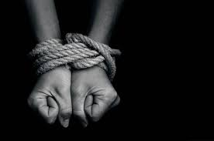
Romans 6:16 NLT
Don’t you realize that you become the slave of whatever you choose to obey? You can be a slave to sin, which leads to death, or you can choose to obey God, which leads to righteous living.

Slide 22
Twelve Steps
We admitted we were powerless over _______–that our lives had become unmanageable.
Admitted to God, to ourselves and to another human being the exact nature of our wrongs.
Made direct amends to such people wherever possible, except when to do so would injure them or others.

Slide 23
This is the Test of Obedience
³ And we can be sure that we know him if we obey his commandments. ⁴ If someone claims, “I know God,” but doesn’t obey God’s commandments, that person is a liar and is not living in the truth. ⁵ But those who obey God’s word truly show how completely they love him. That is how we know we are living in him.
1 John 2:3-6 NLT
Do You Pass?
If not, are you ready today to trade in slavery to sin for freedom in Christ?
When we are free,
we hate the sin we once loved.

