Slide 1
The Magi

Slide 2
Matthew 2:1-7
2 When Jesus was born in the village of Bethlehem in Judea, Herod was king. During this time some wise men from the east came to Jerusalem ² and said, “Where is the child born to be king of the Jews? We saw his star in the east and have come to worship him.” ³ When King Herod heard about this, he was worried, and so was everyone else in Jerusalem. ⁴ Herod brought together the chief priests and the teachers of the Law of Moses and asked them, “Where will the Messiah be born?” ⁵ They told him, “He will be born in Bethlehem, just as the prophet wrote, ⁶ ’Bethlehem in the land of Judea, you are very important among the towns of Judea. From your town will come a leader, who will be like a shepherd for my people Israel.’” ⁷ Herod secretly called in the wise men and asked them when they had first seen the star.

Slide 3
Matthew 2:8-12
He told them, “Go to Bethlehem and search carefully for the child. As soon as you find him, let me know. I want to go and worship him too.” The wise men listened to what the king said and then left. And the star they had seen in the east went on ahead of them until it stopped over the place where the child was. ¹⁰ They were thrilled and excited to see the star.
¹¹ When the men went into the house and saw the child with Mary, his mother, they knelt down and worshiped him. They took out their gifts of gold, frankincense, and myrrh and gave them to him. ¹² Later they were warned in a dream not to return to Herod, and they went back home by another road.

Slide 4
Matthew 2:1-2
When Jesus was born in the village of Bethlehem in Judea, Herod was king. During this time some wise men from the east came to Jerusalem and said, “Where is the child born to be king of the Jews? We saw his star in the east and have come to worship him.”

Slide 5
Who were the Magi
Gentiles
Lived in the East (east of Jerusalem)
Possibly Babylon, Persia, India
Science, Prophecy, History
Knew Jewish History

Slide 6
The Star
Magi knew stars, galaxies
Not Astrologists, ie Horoscopes etc.
Astronomers
Something new in the sky to the west

Slide 7
Numbers 24:17 (Baalom 1450 BC)
“I see Him but not now
I behold Him but not near
A star shall come forth from Jacob
A scepter shall rise from Israel”

Slide 8
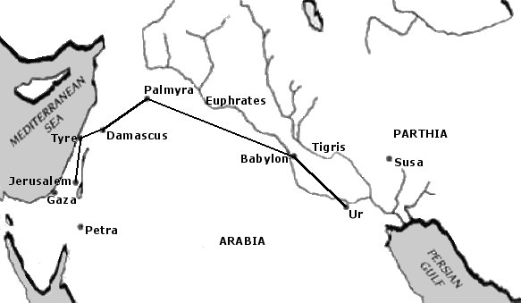
Route traveled by the Wise Men

Slide 9
Ecclesiastes 3:11
“He has set eternity
in the hearts of man.”

Slide 10
Romans 1:20
“For since the creation of the world His
invisible attributes, His eternal power and
divine nature have been clearly seen
being understood through what has been
made, so they are without excuse.”

Slide 11
Star to the West
Scepter – Israel
Head for Jerusalem
Gas up the camels – oops I mean horses

Slide 12
Did they Understand?
Daniel 9:26 – Decree to rebuild Jerusalem
Until Messiah comes and in “cut off” 476 years
Nehemiah 2:8 – Decree to rebuild (446 BC)

Slide 13
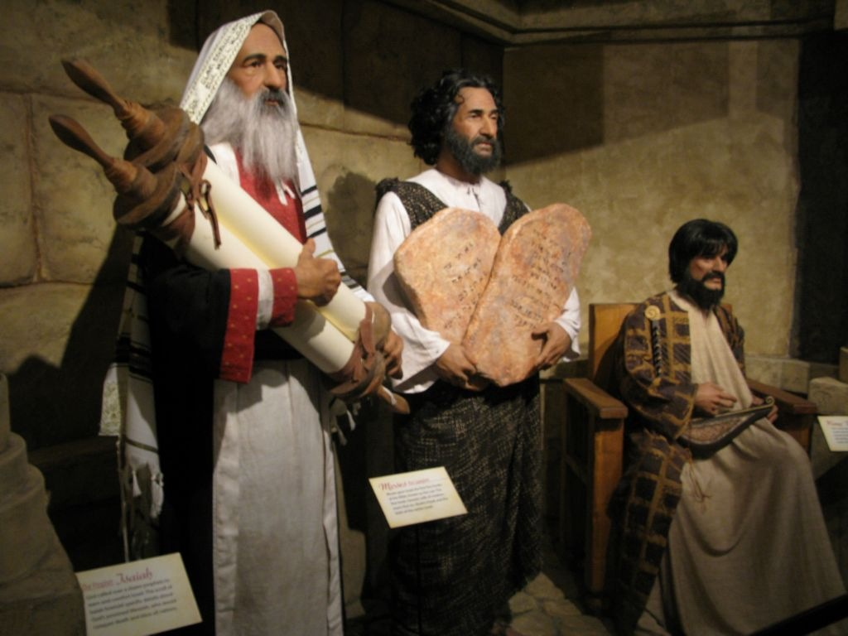

Slide 14
Matthew 2:3
When King Herod heard about this, he was worried, and so was everyone else in Jerusalem.

Slide 15
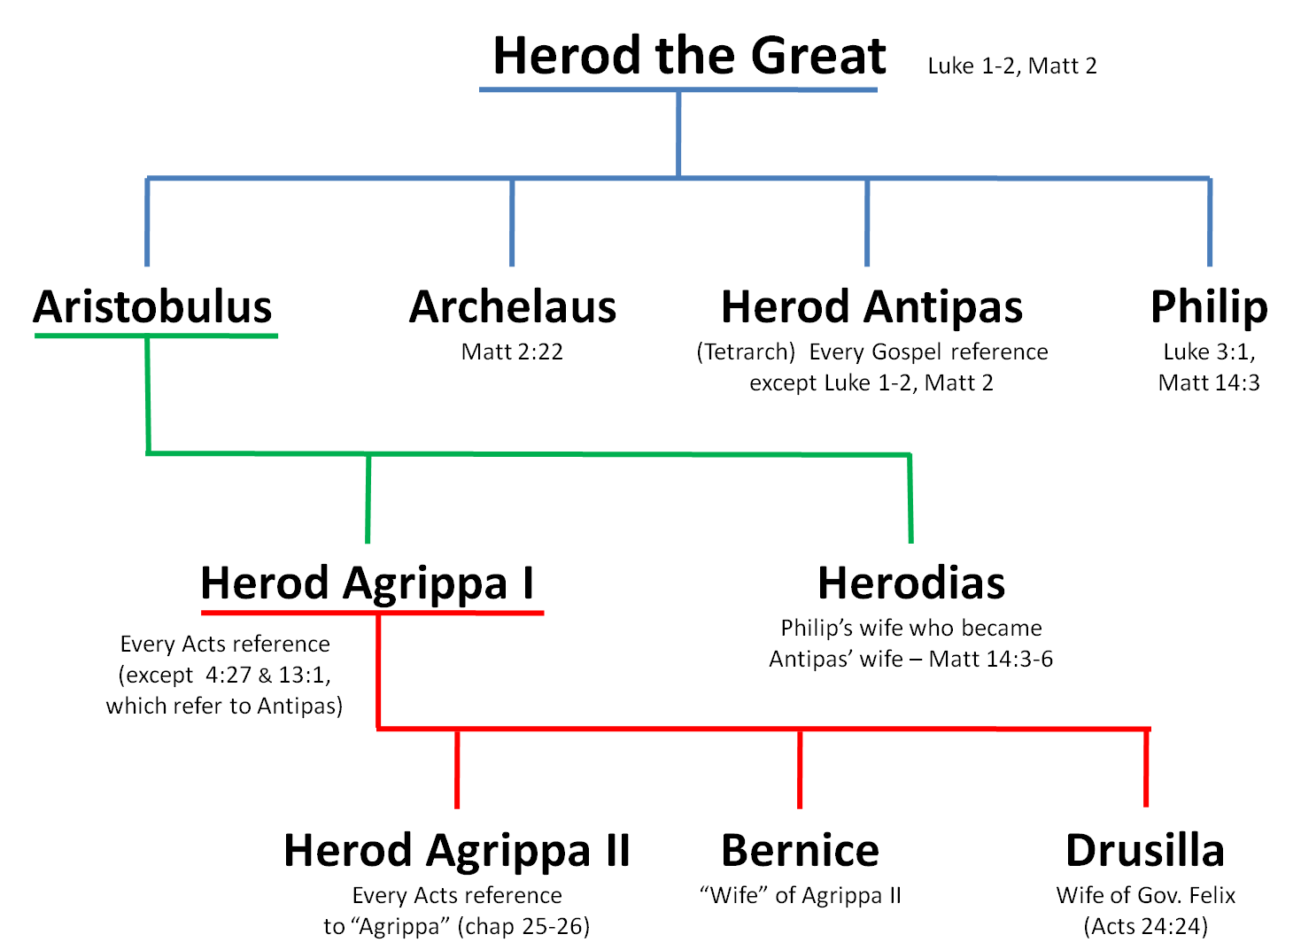

Slide 16
Herod the Great
Not Jewish, Esau’s descendent
63 B.C. – became Governor of Jerusalem
40 B.C. – Parthian invasion, escape to Rome
“King of the Jews”
40,000 Soldiers

Slide 17
Matthew 2:4-6
“Interested to know but not to go”
Herod brought together the chief priests and th teachers of the Law of Moses and asked them, “Where will the Messiah be born?” T hey told him, “He will be born in Bethlehem, just as the prophet wrote,
‘Bethlehem in the land of Judea, you are very important among the towns of Judea. From your town will come a leader, who will be like a shepherd for my people Israel.”

Slide 18
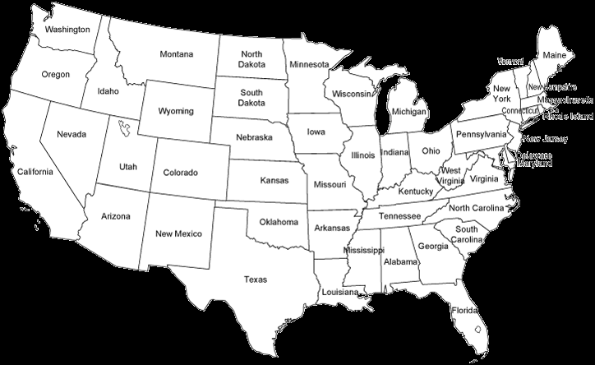

Slide 19
Boston Scholars
Major of Wichita
Professors or Preachers
Go to Hilltop
Jesus can be born in your heart
Here in HILLTOP

Slide 20
Matthew 2:7-8
“Herod secretly called in the wise men and asked them when they had first seen the star. He told them, ‘Go to Bethlehem and search carefully for the child. As soon as you find him, let me know. I want to go and worship him too.’”

Slide 21
Matthew 2:9-10
“The wise men listened to what the king said and then left. And the star they had seen in the east went on ahead of them until it stopped over the place where the child was. They were thrilled and excited to see the star.”

Slide 22
Matthew 2:11
“When the men went into the house and saw the child with Mary, his mother, they knelt down and worshiped him. They took out their gifts of gold, frankincense, and myrrh[a] and gave them to him.”

Slide 23
Matthew 2:12
“Later they were warned in a dream not to return to Herod, and they went back home by another road.”

Slide 24
How does God warn us?
Scripture
Prayer
Conscience
Godly advice
Dreams

Slide 25
Dreams
Wise Men – Matthew 2:12 – Avoid Herod
Joseph – Matthew 1:20 – Marry Mary
Matthew 2:13 – Flee to Egypt
Matthew 2:19 – Return to Israel
Matthew 2:22 – Settle in Nazareth

Slide 27
Matthew 7:7
“Ask, and you will receive.
Search, and you will find.
Knock, and the door will be opened for you.”

Slide 28
Psalms 145:18
“You are near to everyone whose prayers are sincere.”

Slide 29
Isaiah 55:6
“Seek the Lord
while He may be found.”

Slide 30
Revelations 3:20
“I stand at the door and knock.
If anyone hear my voice
and open the door
I will come into their life
I will share things together as friends.”

Slide 31
Table Talk
How has God ever warned you?
What special ways has God spoken to you?

