Slide 1
The Week in Review
What Happened

Slide 2
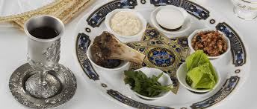
Why do the Jewish Passover and Christian Easter occur close together every year?

Slide 3
How are these dates calculated?
Put on your thinking cap!
Start with March 21st when the sun is directly over the Equator (equinox ) days and nights are the same length.
Look in the sky for the next full moon, Christian Good Friday, Jewish Passover. Sunday 3 days later is Easter. 22 March — 25 April, this year 21 April.

Slide 4
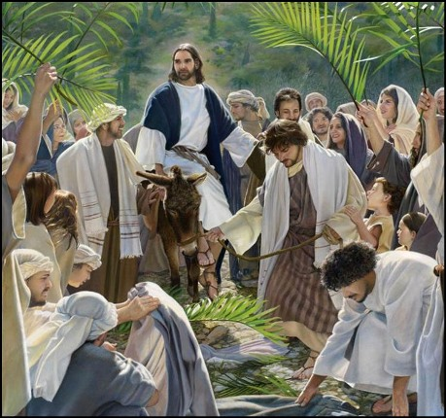

Slide 5
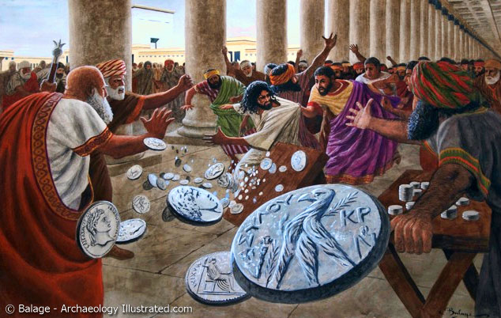

Slide 6
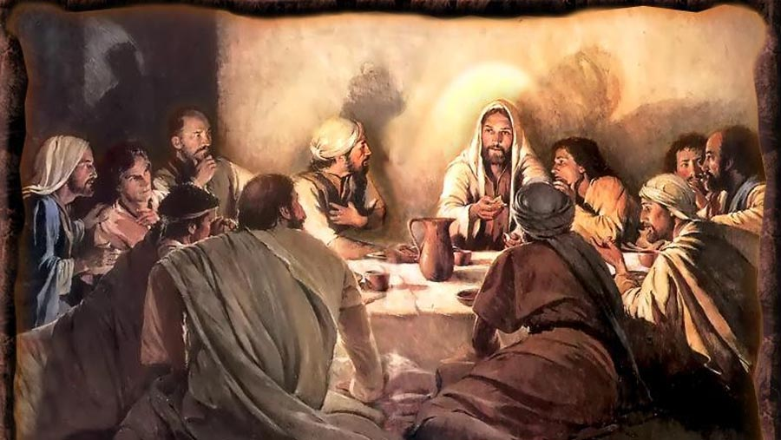

Slide 7
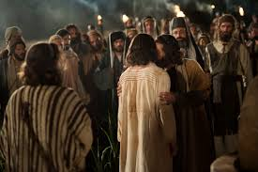
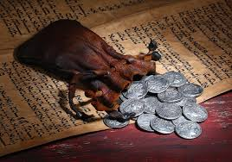
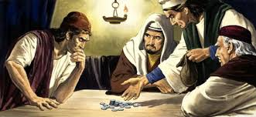

Slide 8
Jewish Laws Concerning Capital Crimes
No arrest without a charge
Arrest officers were also judges
Trial after morning worship until noon
No self incrimination
2 witnesses, 2 judges, 2 days
Not before Passover

Slide 9
Did Jesus ever say
He was God?

Slide 10
Luke 22:70
“They all said, ‘Are you the Son of God?’ Jesus replied to them, “Yes I am”.

Slide 11
Miscarriage of Justice
Sanhedrin: “Guilty of Blasphemy”

Slide 12
Miscarriage of Justice
To Pilate: “Guilty of Treason”
Misleads people
Don’t pay taxes
Claims to be Christ a King

Slide 13
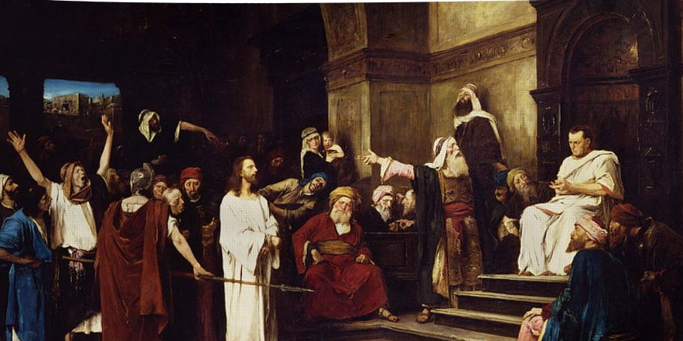
Pilate “Are you King of the Jews?”
Jesus “It is as you say…”
Pilate “I find no fault.”

Slide 14
3 Jewish Trials
Annas
Caiaphas
Sanhedrin

Slide 15
3 Roman (Gentile) Trials
Pilate
Herod Antipas
Pilate

Slide 16
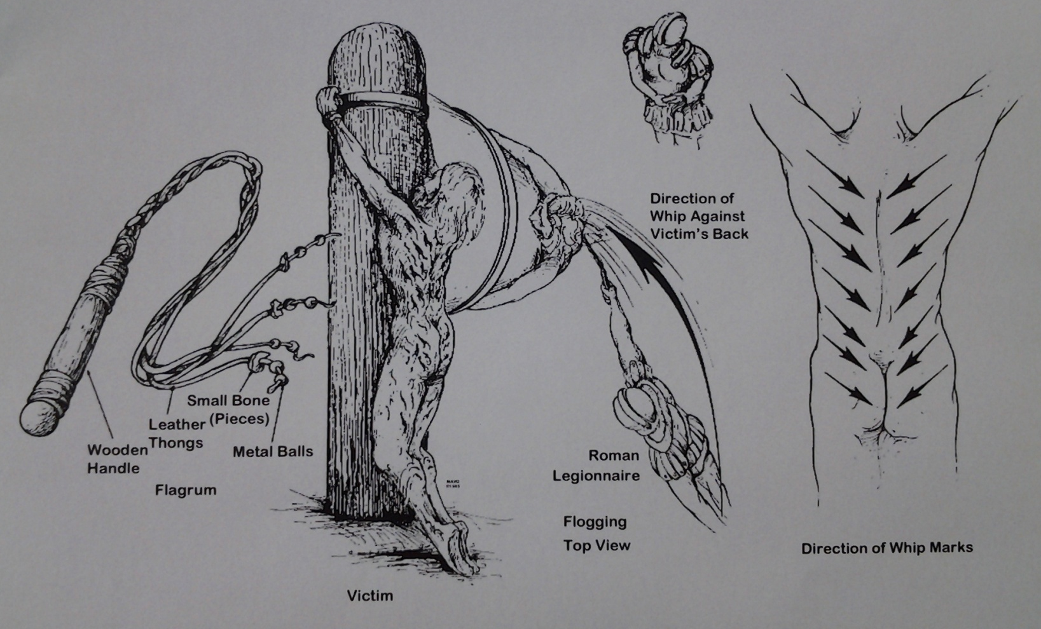
Isaiah 53:5
“With His stripes we are healed”
Spiritual Healing
Forgiven and Saved

Slide 17
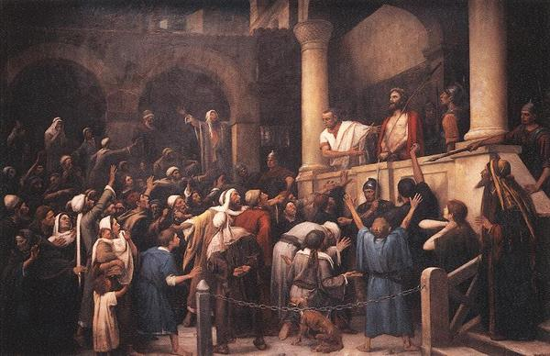

Slide 18
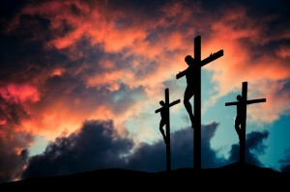
“Father forgive them, for they do not know what they are doing.”

Slide 19
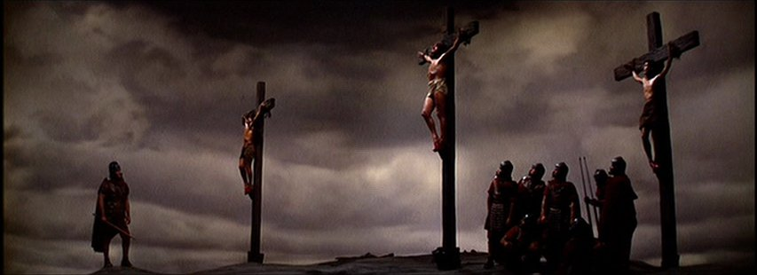
2 Thieves with Jesus, “I tell you the truth today you will be with Me in Paradise.”

Slide 20
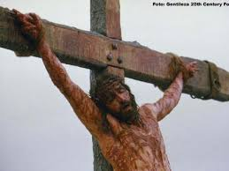
IT IS FINISHED
Seek and to Save the Lost

Slide 21
Table Talk
Which thief are you?
“If you are The Christ…”
Or
“Jesus, remember me when you
come in your Kingdom.”

