Slide 1
TRUE
NORTH
Values * Mission * Vision

Slide 2
TRUE
NORTH
Team Ministry
Growing Leaders

Slide 3
TEAM
MINISTRY
All our ongoing ministries will be led by teams of people who are called to those ministries, who decide how to do those ministries within the church’s vision and values. Leaders grow mainly through serving on teams. Every team leader and house church shepherd will be supported by and accountable to a coach.

Slide 4
Better Together 1 Corinthians 12:1, 4-6, 21
Now concerning spiritual gifts, brothers, I do not want you to be uninformed.
Now there are varieties of gifts, but the same Spirit; and there are varieties of service, but the same Lord; and there are varieties of activities, but it is the same God who empowers them all in everyone.
The eye cannot say to the hand, “I have no need of you,” nor again the head to the feet, “I have no need of you.”

Slide 5
A Ministry Team Is…
a small group of people
who are all called
to the same ministry,
who love and trust each other
and who decide, within boundaries, how to
do that ministry together.

Slide 6
6 Characteristics of a Ministry Team
Size: A small group of people
Call: Who are all called
Focus: To the same ministry
Relationship: Who love and trust each other
Empowerment: And who decide, within boundaries, how to
Collaboration: Do that ministry together

Slide 7
Committees vs. Ministry Teams
Committees
May include people not doing the ministry
Make decisions about ministry--often other people’s ministry.
Members serve based on willingness and availability
Leader works with those assigned to the committee
Level of trust and transparency is often low. Vigorous, creative conflict may be rare.
Often have limited authority to change ministry strategy
Ministry Teams
Are made up of those doing the ministry
Do ministry--and makes decisions about own ministry. All members are working members.
Members serve based on call
Ideally, leader has final say about who is on the team
Trust is high. It is safe to disagree. Vigorous, creative conflict is normal.
Can follow any strategy consistent with the church’s stated vision and values

Slide 8
Where do leaders come from?
“Inviting people to join healthy teams
is by far
our most effective
leadership development strategy.”
The More-with-Less Church

Slide 9
GROWING
LEADERS
We are passionate about growing “oral culture” leaders. Leaders with roots in the culture of poverty are normally best able to understand and connect with those we are called to reach. We also value bicultural (print/oral ) leaders. Their primary role is to help oral culture leaders succeed through (1) assisting oral culture leaders, (2) co-leading with them, (3) coaching, or (4) jump starting a new effort and then entrusting it to others.

Slide 10
“The gifts he gave were that some would be apostles, some prophets, some evangelists, some pastors and teachers, to equip the saints for the work of ministry.”
Ephesians 4:11-12, NRSV

Slide 11
After 20 years…
10 years ago
Hilltop Urban Church was known as a place of extraordinary compassion and grace, but…
…almost no one from the neighborhood had grown into spiritual leadership.
…we had very little long-term fruit to show for two decades of ministry to children and youth.
…we were just as dependent as ever on outside financial subsidy.
…it was a constant challenge just to maintain. Dreams of multiplying our ministry seemed totally out of reach.

Slide 12
Why were we stuck?
We had transplanted suburban ways of doing church to urban soil. So, we had to rely on suburban workers and suburban money to do suburban-style ministry. Every ministry program was led by middle-class people, not people from the local community.

Slide 13
Middle-Class Church Requires…
Money: Lots of funds for buildings and professional staff
Organizational skills: Experience managing institutions and big programs
Academic skills: Reading, writing, and classes are primary ways of learning and teaching.

Slide 14
Money, organizational skills, and academic skills are abundant in most middle-class churches, but when low-income churches try to do church this way, they usually struggle.

Slide 15
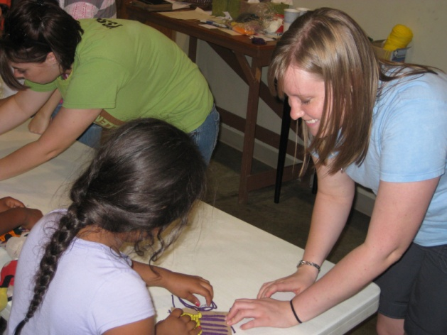
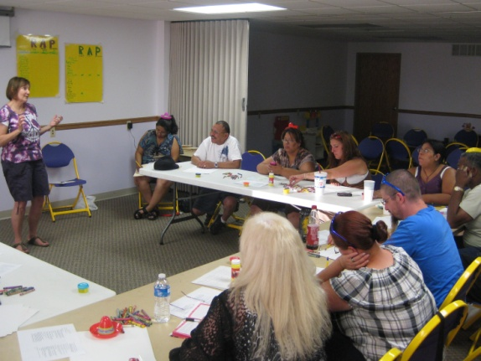
Family Bash

Slide 16
Bicultural Leaders
Bicultural (oral/print) leaders are critical to the mission of HUC. They can be strategic in helping oral culture leaders succeed through:
Serving on a team led by oral culture leaders
Co-leading with them
Coaching
Jump starting a new effort and then entrusting it to others

Slide 17
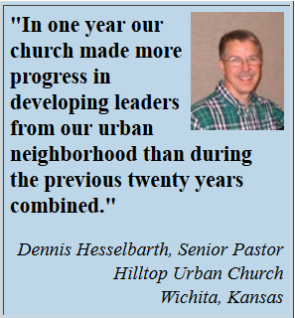
Growing Leaders
How many ministry leaders
from the culture HUC is called to serve?
10 years ago: 0
Today: About 80%
Raising up leaders from the culture HUC is called to serve (indigenous leaders) is essential to our being able to fulfill HUC’s vision…

Slide 18
Our Vision
To see life-changing house churches
where open-heart surgery takes place regularly
throughout the Wichita area
wherever there are pockets of poverty.

