Slide 1
Two Debtors

Slide 2
Luke 7:36-50
Jesus Anointed by a Sinful Woman
³⁶ When one of the Pharisees invited Jesus to have dinner with him, he went to the Pharisee’s house and reclined at the table. ³⁷ A woman in that town who lived a sinful life learned that Jesus was eating at the Pharisee’s house, so she came there with an alabaster jar of perfume. ³⁸ As she stood behind him at his feet weeping, she began to wet his feet with her tears. Then she wiped them with her hair, kissed them and poured perfume on them.
³⁹ When the Pharisee who had invited him saw this, he said to himself, “If this man were a prophet, he would know who is touching him and what kind of woman she is—that she is a sinner.”
⁴⁰ Jesus answered him, “Simon, I have something to tell you.”
“Tell me, teacher,” he said.

Slide 3
⁴¹ “Two people owed money to a certain moneylender. One owed him five hundred denarii, and the other fifty. ⁴² Neither of them had the money to pay him back, so he forgave the debts of both. Now which of them will love him more?”
⁴³ Simon replied, “I suppose the one who had the bigger debt forgiven.”
“You have judged correctly,” Jesus said.
⁴⁴ Then he turned toward the woman and said to Simon, “Do you see this woman? I came into your house. You did not give me any water for my feet, but she wet my feet with her tears and wiped them with her hair. ⁴⁵ You did not give me a kiss, but this woman, from the time I entered, has not stopped kissing my feet. ⁴⁶ You did not put oil on my head, but she has poured perfume on my feet. ⁴⁷ Therefore, I tell you, her many sins have been forgiven—as her great love has shown. But whoever has been forgiven little loves little.”
⁴⁸ Then Jesus said to her, “Your sins are forgiven.”
⁴⁹ The other guests began to say among themselves, “Who is this who even forgives sins?”
⁵⁰ Jesus said to the woman, “Your faith has saved you; go in peace.”

Slide 4
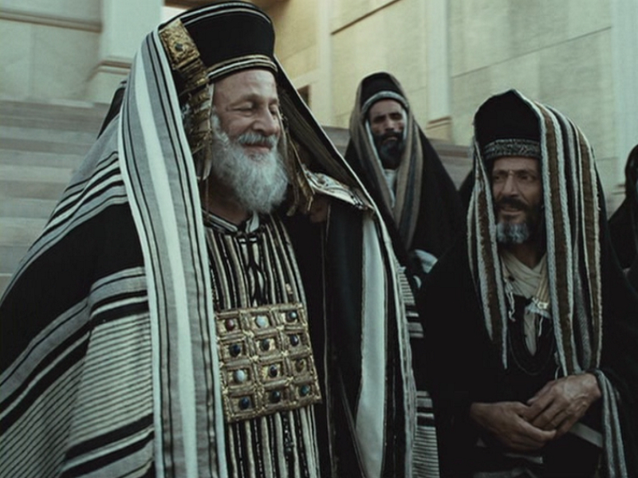
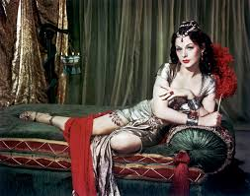

Slide 5
“INTRODUCTION”
Luke 7:36
When one of the Pharisees invited Jesus to have dinner with him, he went to the Pharisee’s house and reclined at the table.

Slide 6
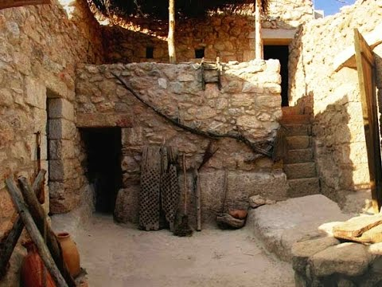
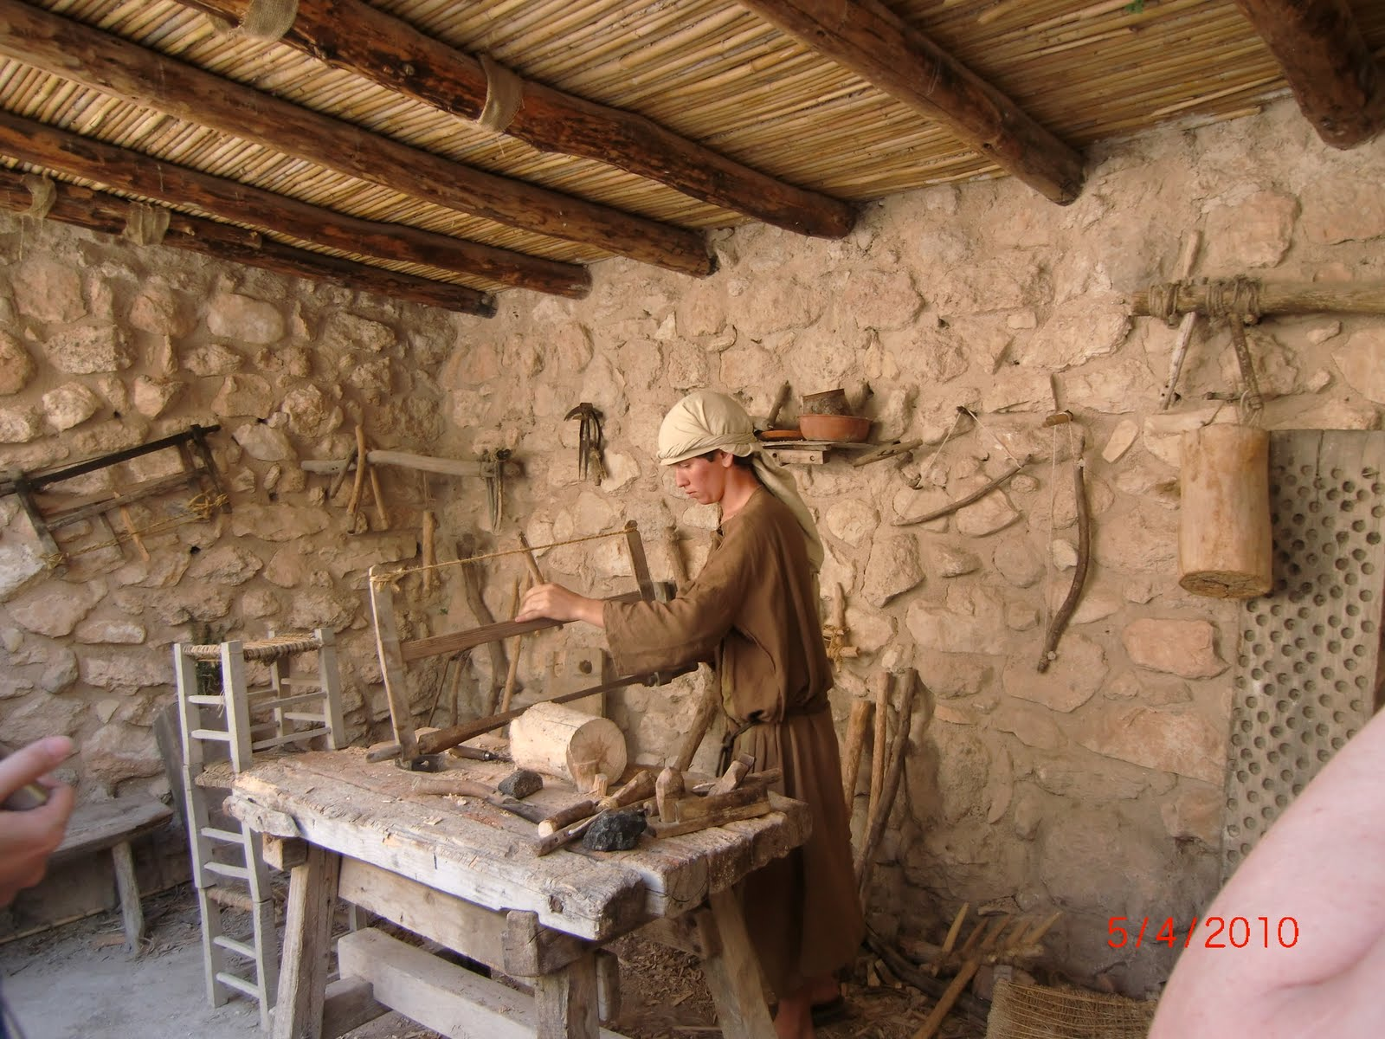

Slide 7
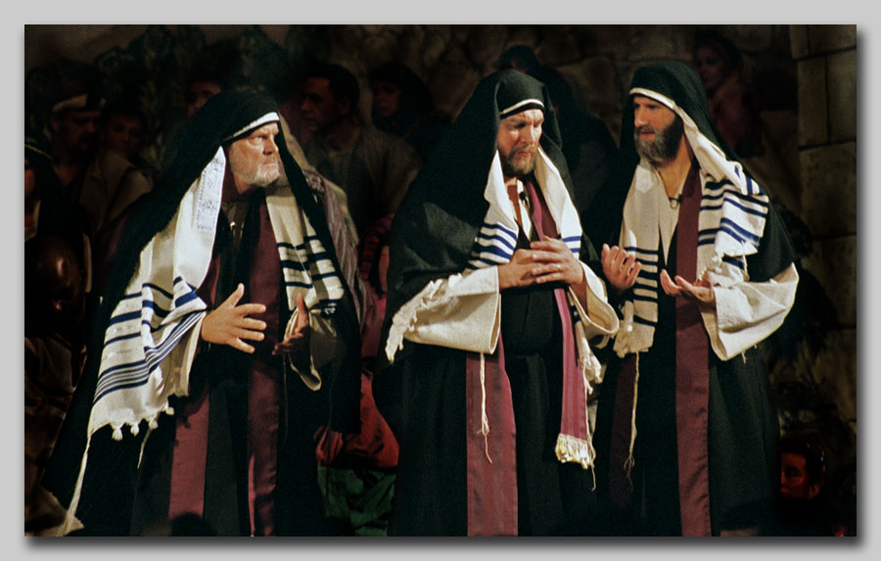

Slide 8
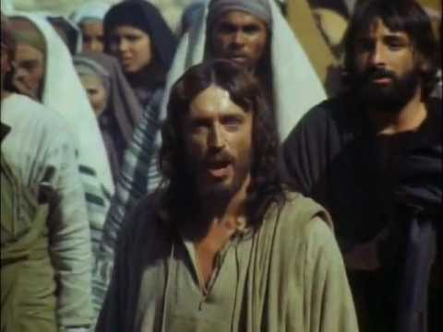

Slide 9
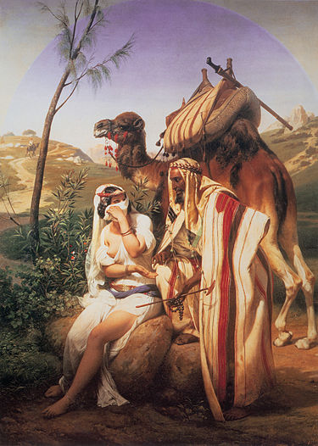

Slide 10
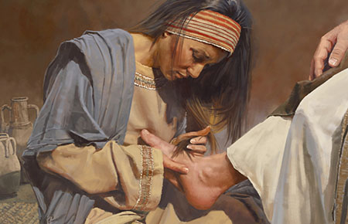
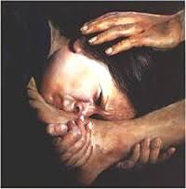
^{Luke 7:37-38}
A woman in that town who lived a sinful life learned that Jesus was eating at the Pharisee’s house, so she came there with an alabaster jar of perfume. ³⁸ As she stood behind him at his feet weeping, she began to wet his feet with her tears. Then she wiped them with her hair, kissed them and poured perfume on them.

Slide 11
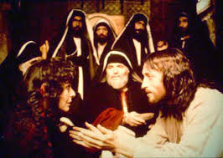
^{Luke 7:39}
When the Pharisee who had invited him saw this, he said to himself, “If this man were a prophet, he would know who is touching him and what kind of woman she is—that she is a sinner.”

Slide 12
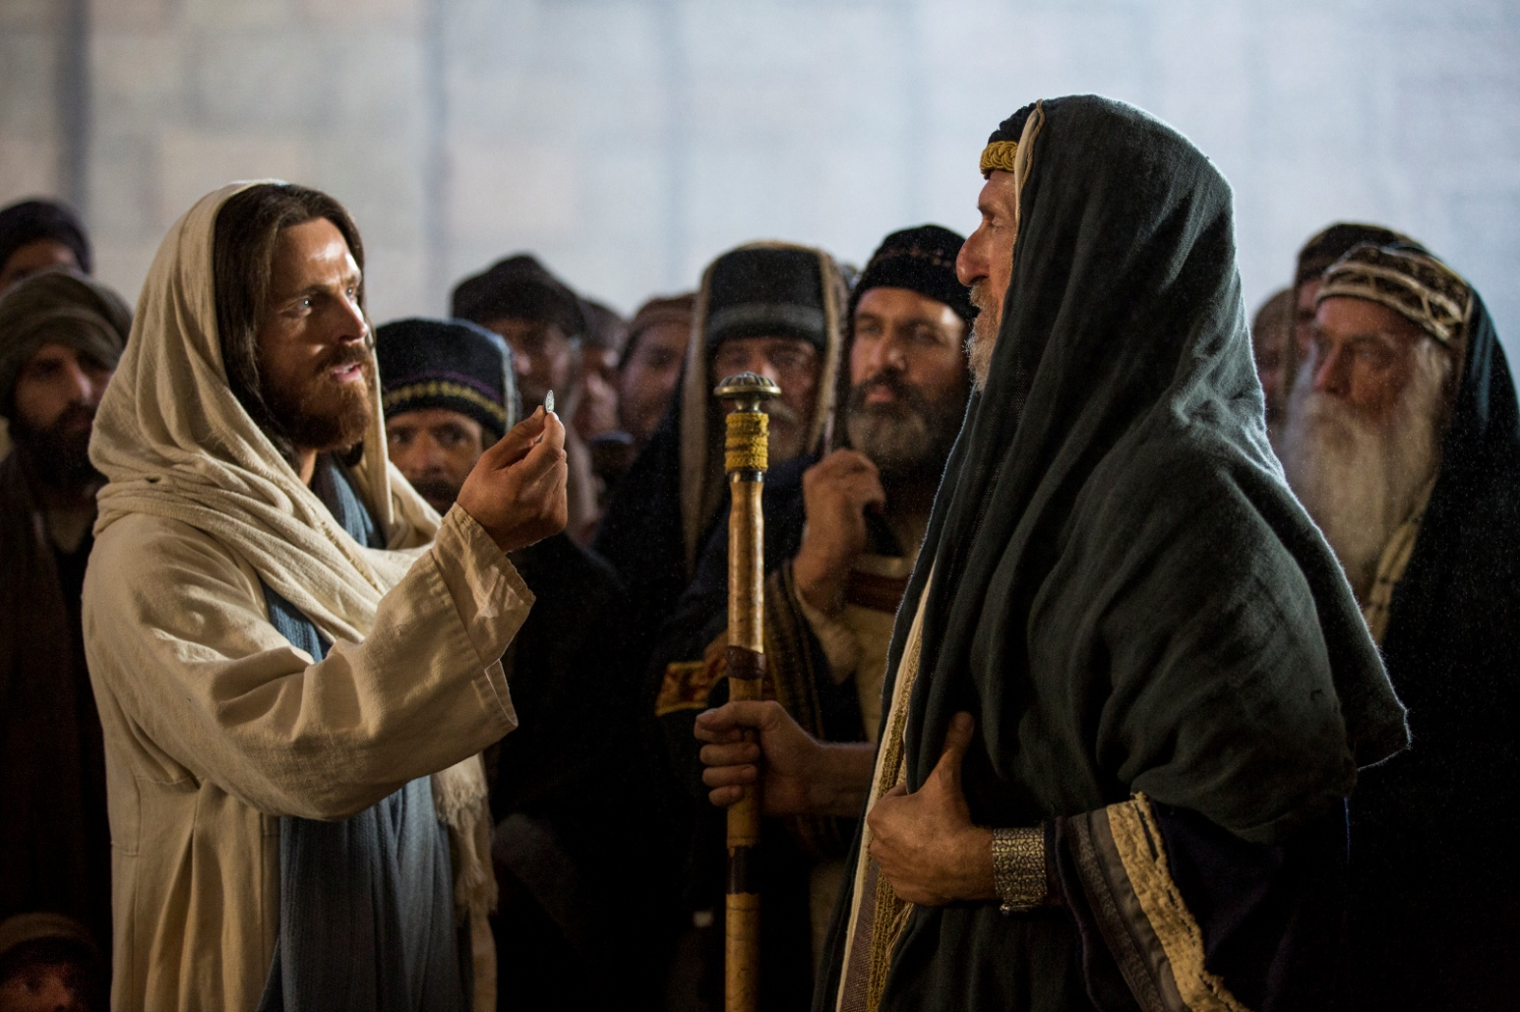
Luke 7:40
Jesus answered him, “Simon, I have something to tell you.” “Tell me, teacher,” he said.

Slide 13
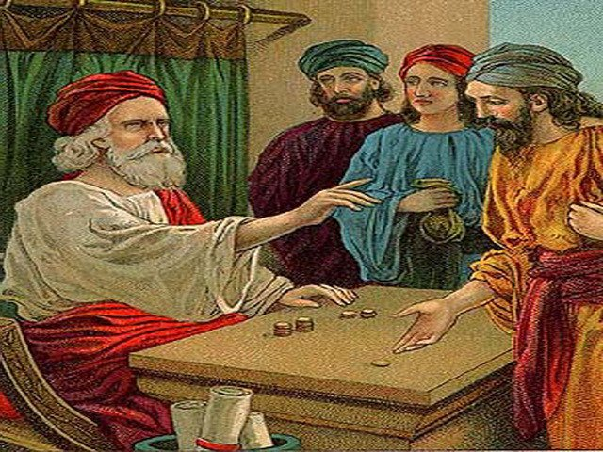
Luke 7:41
“Two people owed money to a certain moneylender. One owed him five hundred denarii,^{[a]} and the other fifty.

Slide 14
500 Denarii vs 50 Denarii
500 Day Pay vs 50 Day Pay
1 Day = 8 hours x $9 = $72
50 Denarii = 50 x $72 = $3600
500 Denarii = $36000

Slide 15
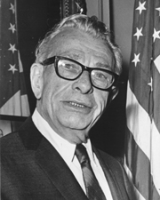
Everett Dirksen,
Senator of Illinois
"A billion here, a billon there. Pretty soon we are talking about real money."

Slide 16
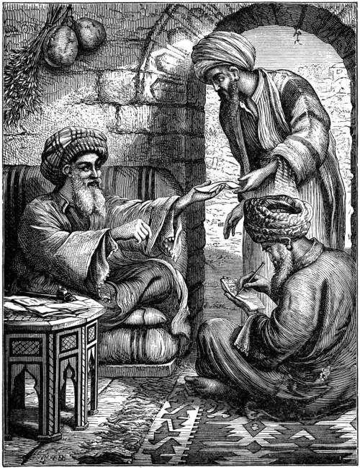
Luke 7:42
Neither of them had the money to pay him back, so he forgave the debts of both. Now which of them will love him more?”

Slide 17
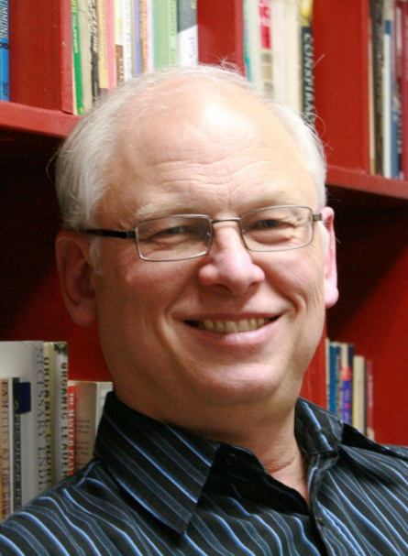
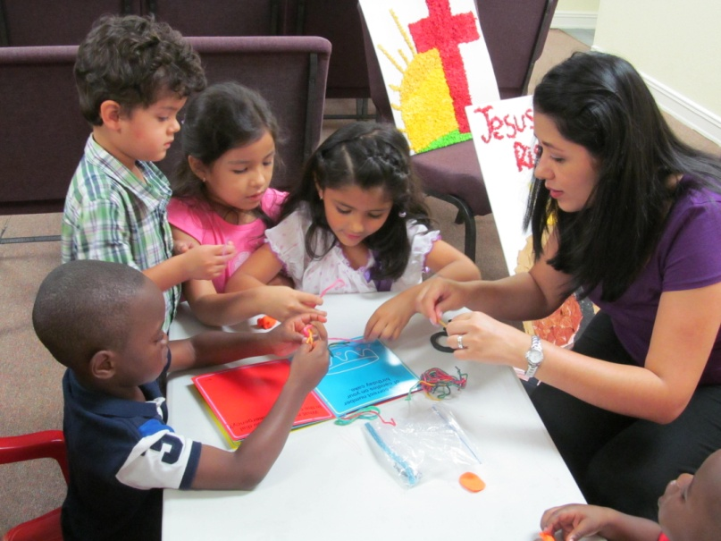
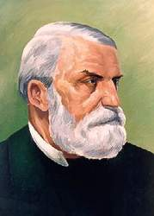

Slide 18
James 2:14
Faith and Deeds
¹⁴ What good is it, my brothers and sisters, if someone claims to have faith but has no deeds? Can such faith save them?
"Can Faith Save Him?"

Slide 19
James 2:20
You foolish person, do you want evidence that faith without deeds is useless?
"Faith Without Works - Dead"

Slide 20
James 2:21
²¹ Was not our father Abraham considered righteous for what he did when he offered his son Isaac on the altar?
"Justified By His Works"

Slide 21
James 2:23
²³ And the scripture was fulfilled that says, “Abraham believed God, and it was credited to him as righteousness,” and he was called God’s friend.
"Abraham Believed GOD"

Slide 22
James 2:26
“As the body without the spirit is dead, so faith without deeds is dead.”
"Faith Without Works Is Dead"

Slide 23
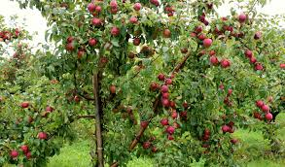
"If you are an Apple Tree,
show me your Apples..."

Slide 24
Luke 7:44-46
Then he turned toward the woman and said to Simon, “Do you see this woman? I came into your house. You did not give me any water for my feet, but she wet my feet with her tears and wiped them with her hair. ⁴⁵ You did not give me a kiss, but this woman, from the time I entered, has not stopped kissing my feet. ⁴⁶ You did not put oil on my head, but she has poured perfume on my feet.
Pharisee vs Prostitute
Wash Feet Water Tears
Towel Hair
Kiss Face Feet
Oil Head Feet

Slide 25
Luke 7:46-47
You did not put oil on my head, but she has poured perfume on my feet. ⁴⁷ Therefore, I tell you, her many sins have been forgiven—as her great love has shown. But whoever has been forgiven little loves little.”
Did Her Good Works Forgive Her Sins?

Slide 26
Luke 7:48
Then Jesus said to her, “Your sins are forgiven.”
Your Sins Are Forgiven!

Slide 27
Luke 7:50
Jesus said to the woman, “Your faith has saved you; go in peace.
“Your Faith Has Saved You”

