Slide 2
The Purpose of John’s Gospel
“The disciples saw Jesus do many other miraculous signs in addition to the ones recorded in this book. But these are written so that you may continue to believe that Jesus is the Messiah, the Son of God, and that by believing in him you will have life by the power of his name.”
John 20:30-31 NLT
What do these signs point to?

Slide 3
The Purpose of John’s Gospel
“The disciples saw Jesus do many other miraculous signs in addition to the ones recorded in this book. But these are written so that you may continue to believe that Jesus is the Messiah, the Son of God, and that by believing in him you will have life by the power of his name.”
John 20:30-31 NLT

Slide 5
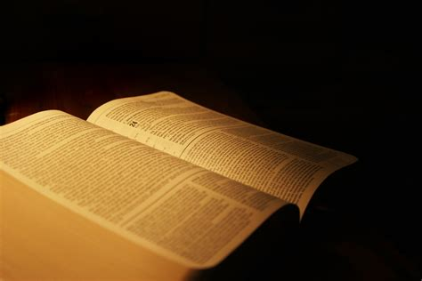
1. What does this story say about people?
2. What does this story say to you about Jesus?
3. What does this story have to say about you?
4. Who needs to hear this story?

Slide 7
John 2:1-11 NLT
The next day there was a wedding celebration in the village of Cana in Galilee. Jesus’ mother was there, ² and Jesus and his disciples were also invited to the celebration. ³ The wine supply ran out during the festivities, so Jesus’ mother told him, “They have no more wine.”
⁴ “Dear woman, that’s not our problem,” Jesus replied. “My time has not yet come.”
⁵ But his mother told the servants, “Do whatever he tells you.”

Slide 8
⁶ Standing nearby were six stone water jars, used for Jewish ceremonial washing. Each could hold twenty to thirty gallons. ⁷ Jesus told the servants, “Fill the jars with water.” When the jars had been filled, ⁸ he said, “Now dip some out, and take it to the master of ceremonies.” So the servants followed his instructions.

Slide 9
⁹ When the master of ceremonies tasted the water that was now wine, not knowing where it had come from (though, of course, the servants knew), he called the bridegroom over. ¹⁰ “A host always serves the best wine first,” he said. “Then, when everyone has had a lot to drink, he brings out the less expensive wine. But you have kept the best until now!”
¹¹ This miraculous sign at Cana in Galilee was the first time Jesus revealed his glory. And his disciples believed in him.

Slide 10
1. What does this story say about people?
2. What does this story say to you about Jesus?
3. What does this story have to say about you?
4. Who needs to hear this story?

Slide 11
BENEDICTION
¹⁶ I pray that from his glorious, unlimited resources he will empower you with inner strength through his Spirit. ¹⁷ Then Christ will make his home in your hearts as you trust in him. Your roots will grow down into God’s love and keep you strong. ¹⁸ And may you have the power to understand, as all God’s people should, how wide, how long, how high, and how deep his love is. ¹⁹ May you experience the love of Christ, though it is too great to understand fully. Then you will be made complete with all the fullness of life and power that comes from God.
²⁰ Now all glory to God, who is able, through his mighty power at work within us, to accomplish infinitely more than we might ask or think. ²¹ Glory to him in the church and in Christ Jesus through all generations forever and ever! Amen.
Ephesians 3:16-21 NLT

